Slide 1
Brand Modernization
Captain Roman Vitanza
National Headquarters Brand Manager
Notes:
We’ve been working on brand modernization since early 2020 – the reason will become clear as we walk through this deck.
This presentation includes a very high-level explanation of why CAP needs to modernize our visual identity and concludes with a proposed solution after many dozens of iterations, presentations, polls, and focus groups.

Slide 2
Brand Objective
As part of Civil Air Patrol’s effort to increase brand awareness and bolster recruiting efforts by turning our focus outward, underperforming and or outdated marketing strategies are being addressed.
Modernizing the visual identity (logo) is an important brand management step that reflects the persona of a dynamic organization.
Notes:
Section 6.4 (page 47) of the approved Marketing & Communications Plan outlines the need for brand modernization to support the Strat Plan.
To grow and sustain the organization we need to do things differently for the next 80 years so we’re no longer “the best kept secret.” Bringing the visual identity into the 21st century is an important step in our ongoing effort to increase the level or organization sophistication as a world-class nonprofit.
CAP spends considerable effort talking to ourselves about ourselves. That’s important in a member-driven organization for retention but retention is not a growth strategy. We need to increase brand awareness and recruiting efforts. The brand needs to be exciting.

Slide 3
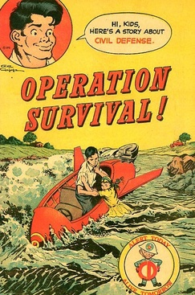
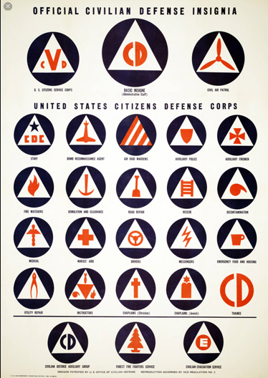
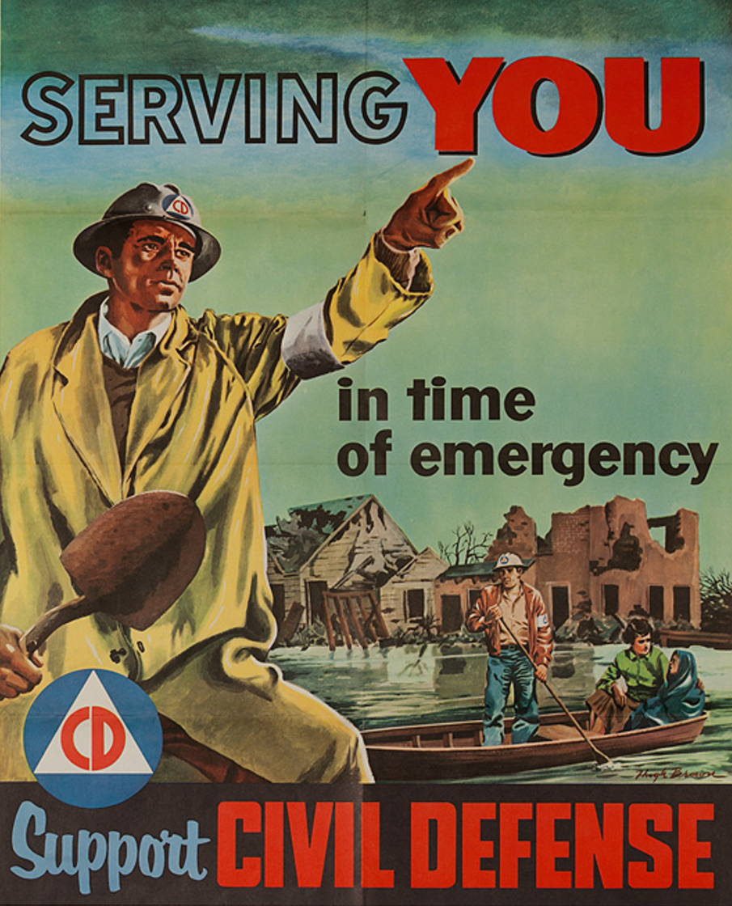
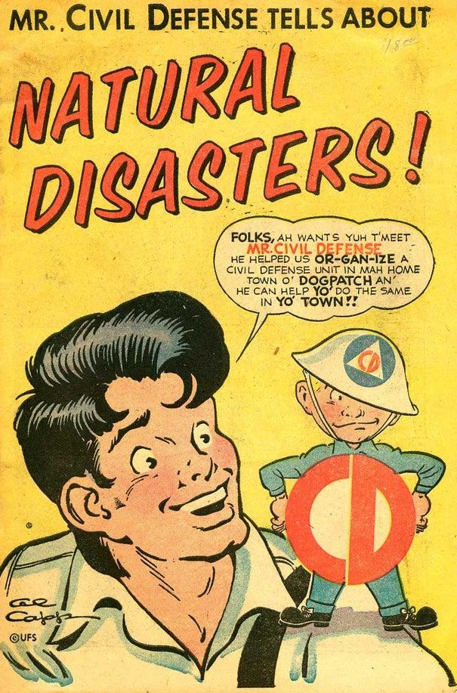
Current State
Civil Air Patrol has a bold new Mission Statement and a comprehensive Strategic Plan married to a mid-20th century identity.
This brand disconnect links Civil Air Patrol to something that hasn't existed in more than 40 years – Civil Defense.
Notes:
CAP has dramatically improved the level of sophistication and effectiveness in Strategic Planning, Philanthropy (accelerated fundraising and Foundation), Innovation, Safety, Operations (cell forensics and radar analysis), ERP, Marketing and Strategic Communications (replaced the PA model) and more just in the past five years. The 80 year old visual identity does not reflect the dynamic and the well managed company that is today’s CAP.

Slide 4
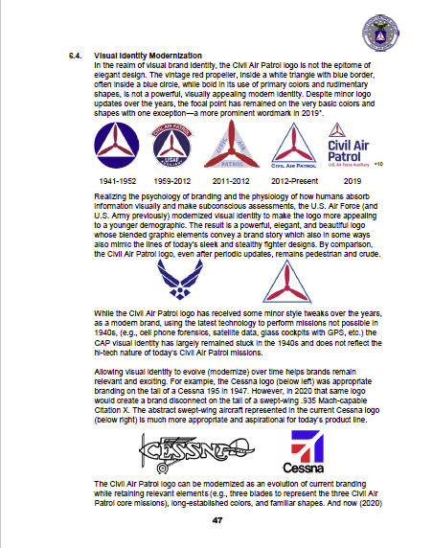
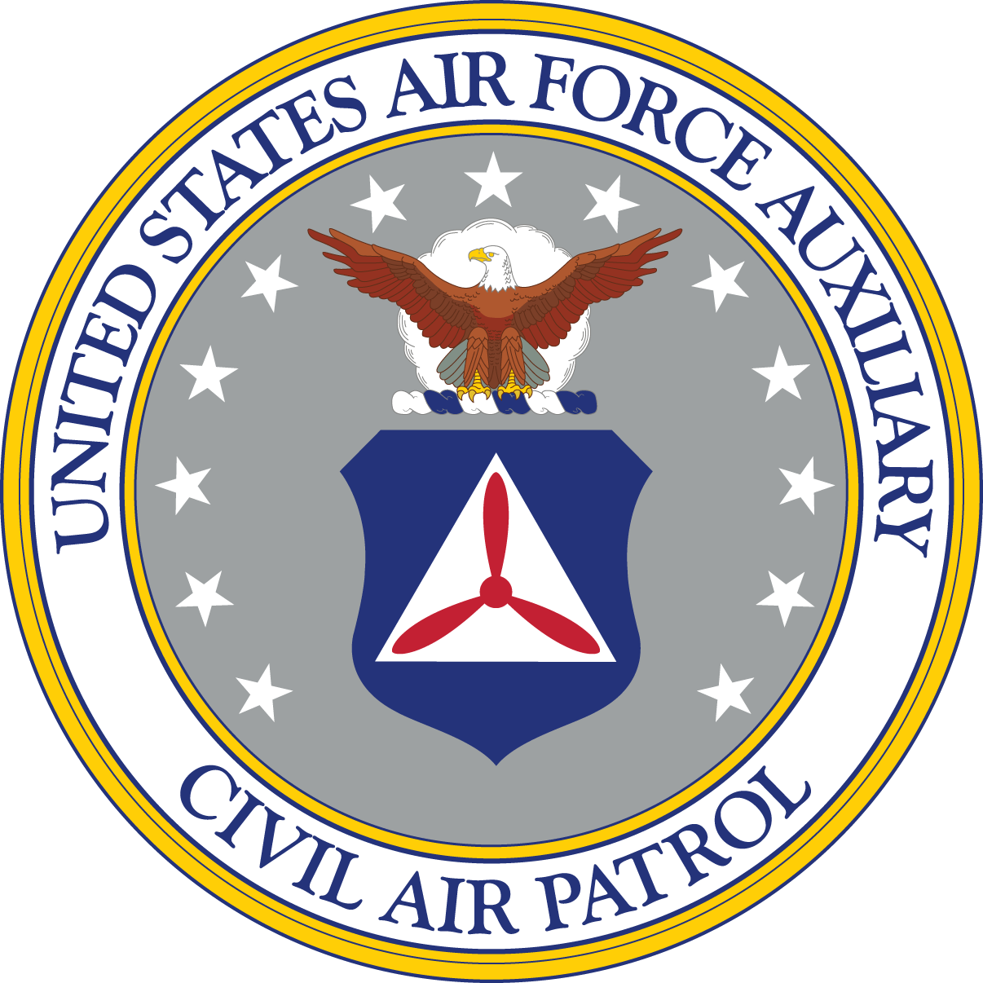
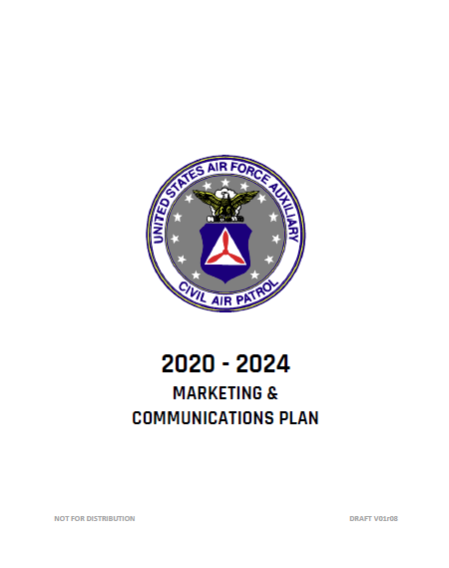
2020-2024 MarCom Plan
Section 6.4 (page 47) of the approved 2020-2024 Marketing & Communications Plan first identified the need for brand modernization.
This presentation is the culmination of two years of effort that culminates in MAC’s recommendation for CAP’s 21st Century identity for better alignment with our Total Force partners.
2020 – 2024
MARKETING & COMMUNICATIONS PLAN
Notes:
The concept has been vetted, trademark searched, and tested with focus groups including select CAP members with marketing experience, random selections of CAP members, CSAG, Command Council, Directors and Chiefs (CAP senior staff), multiple wing conferences, and two national conferences.

Slide 5
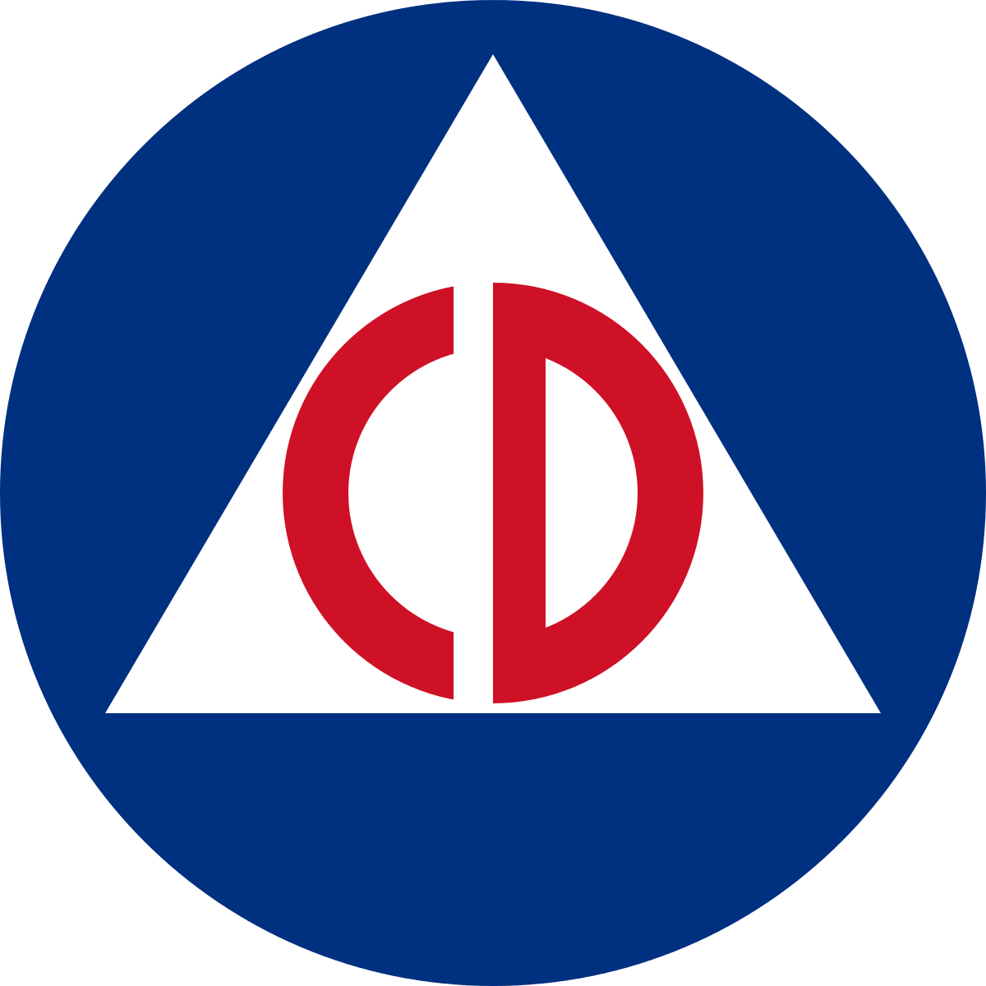

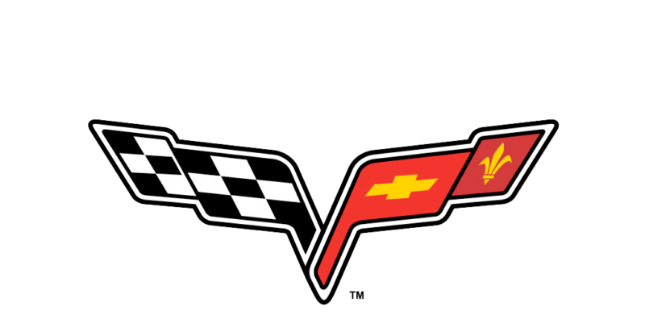


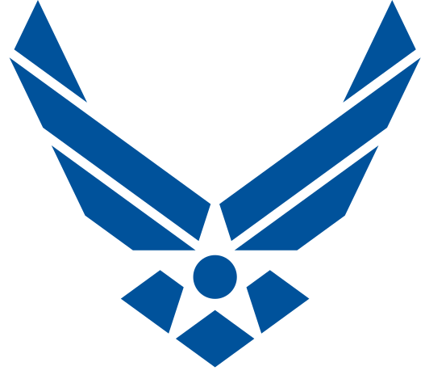
The Journey to Modernization
01
02
03
04
05
06
Current State:
Best Practice:
Rationale:
Readiness:
Case Studies:
Next Steps:
How we got here
Why brands modernize
Why CAP needs a refresh
What members think
How other companies manage
Where we go from here
Notes:
This is the deck we’ve been using for two years to discuss the need to modernize CAP’s visual identity.
I think we all agree that we need to modernize so in the essence of time, I’ve eliminated some of the focus group content so we’ll have more time to consider the solution. Some background info will be valuable for this who haven’t seen this presentation.

Slide 6
How We Got Here
01
Let’s explore the path that produced today’s Civil Air Patrol identity in order to guide our brand strategy forward.
Current State:

Slide 7
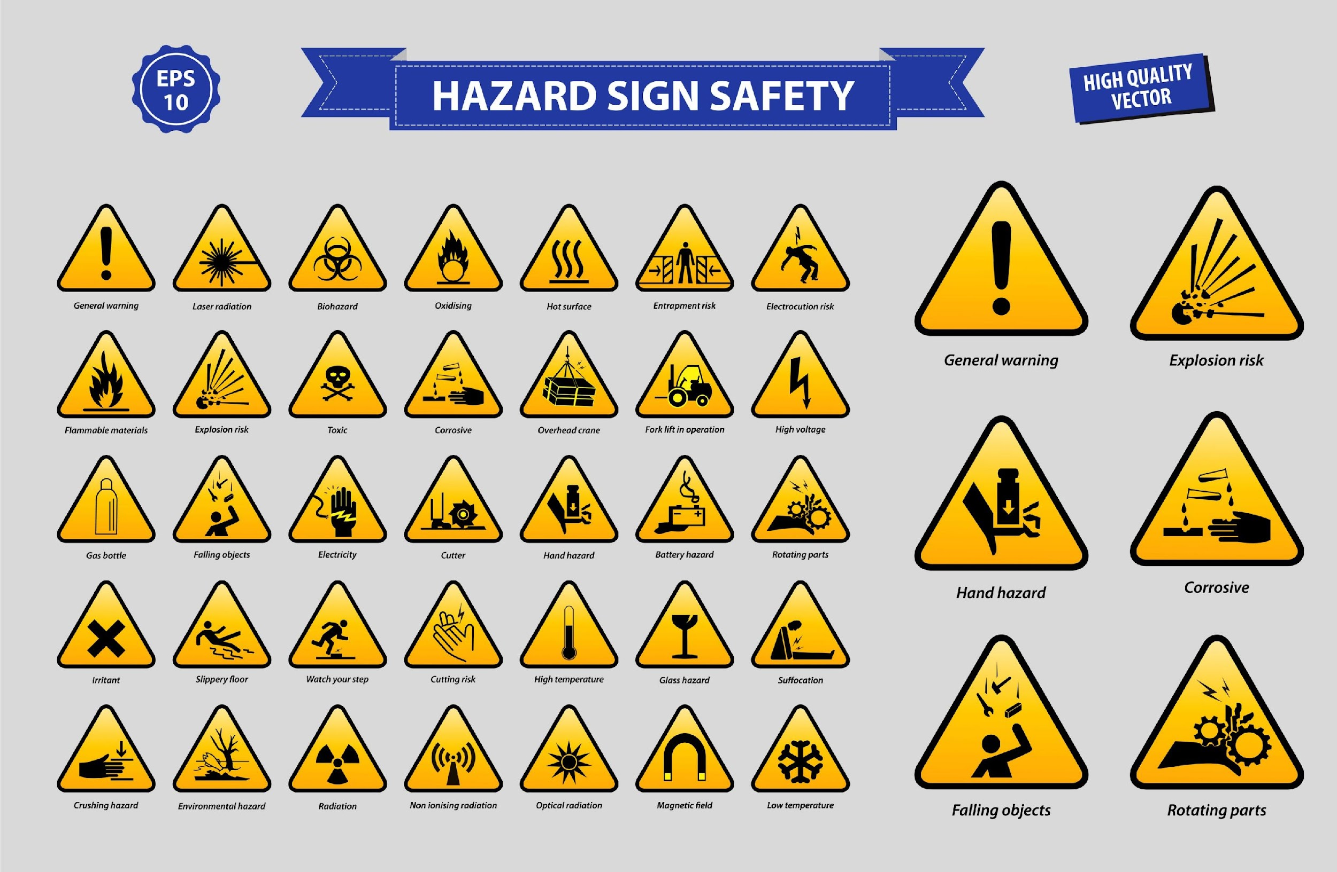
Origin of the CAP Identity
The current visual identity is based on the 1940s suite of now obsolete Civilian Defense iconography.
The Civil Air Patrol icon was not developed as a meaningful brand identity, it was merely an icon for quick reference.
None of these are logos
Notes:
CAP has an icon that by default became our visual identity – it is not a thoughtfully designed logo any more than a safety sign would be considered a logo.

Slide 8

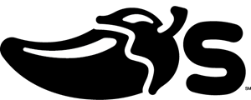







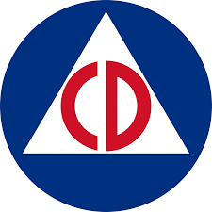
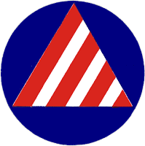



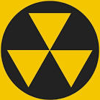
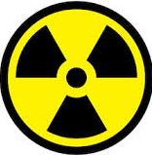



Icons vs. Logos
Logos tells a brand story.
Logos are unique shapes designed to capture the essence of a company or product in a thoughtful way.
Icons are intended to simplify and communicate a message at a glance.
Notes:
A logo should tell a brand story. And our new logo does exactly that.

Slide 9



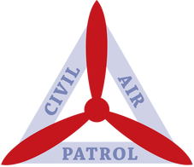
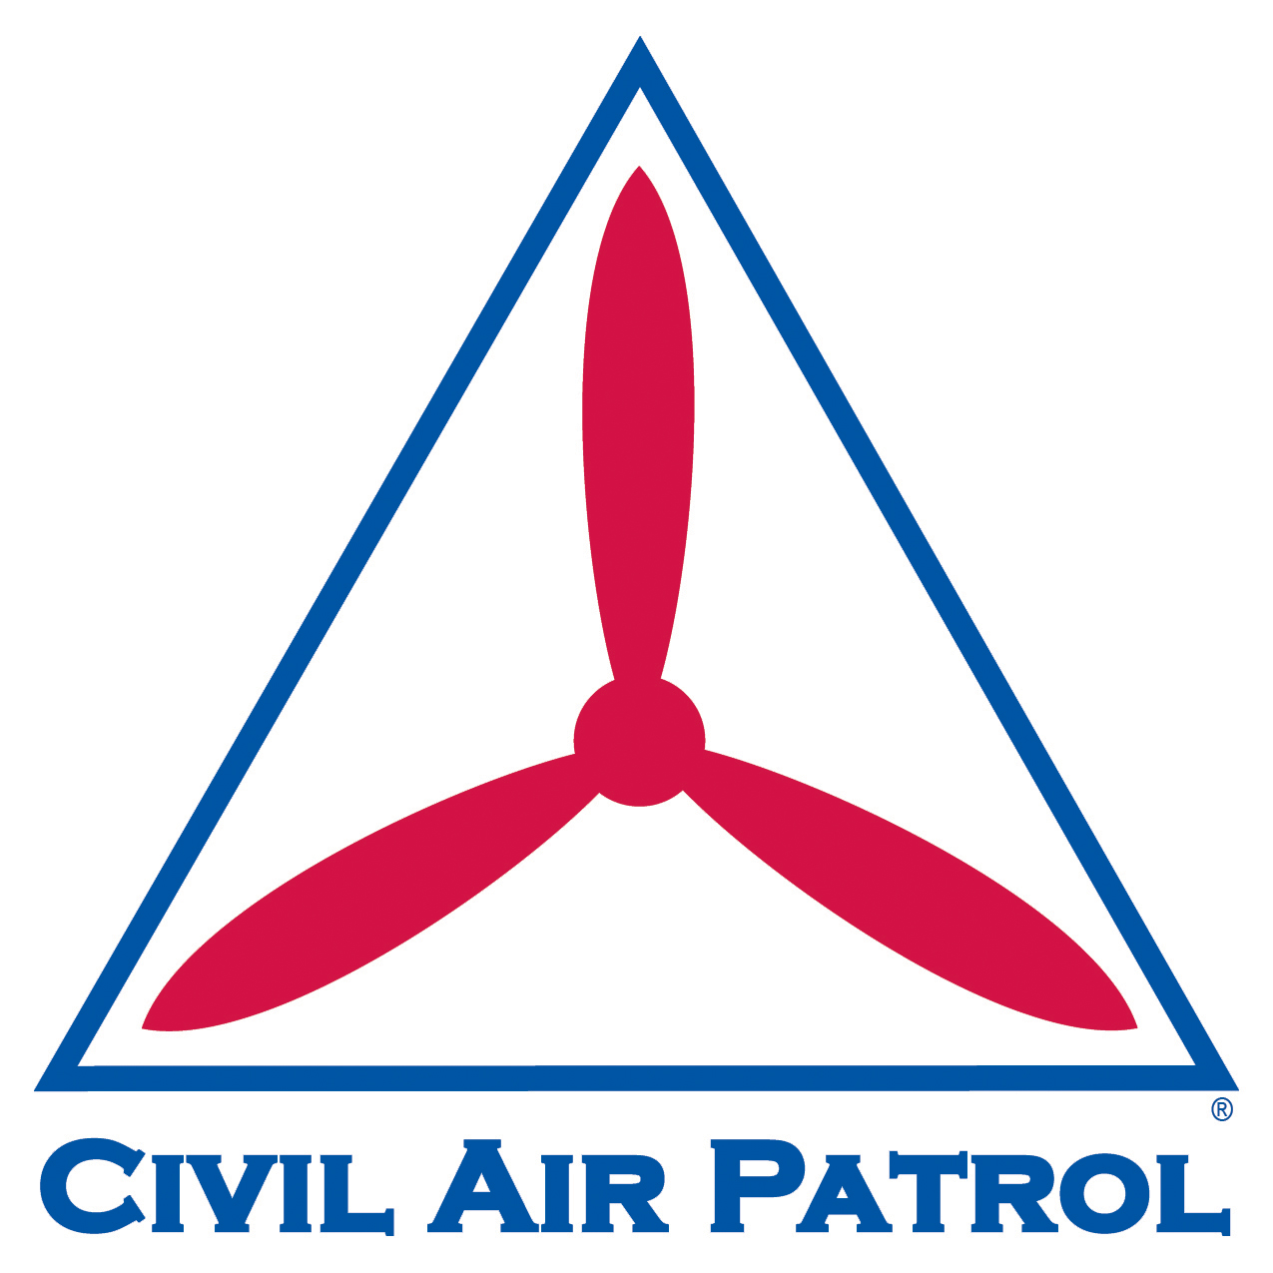
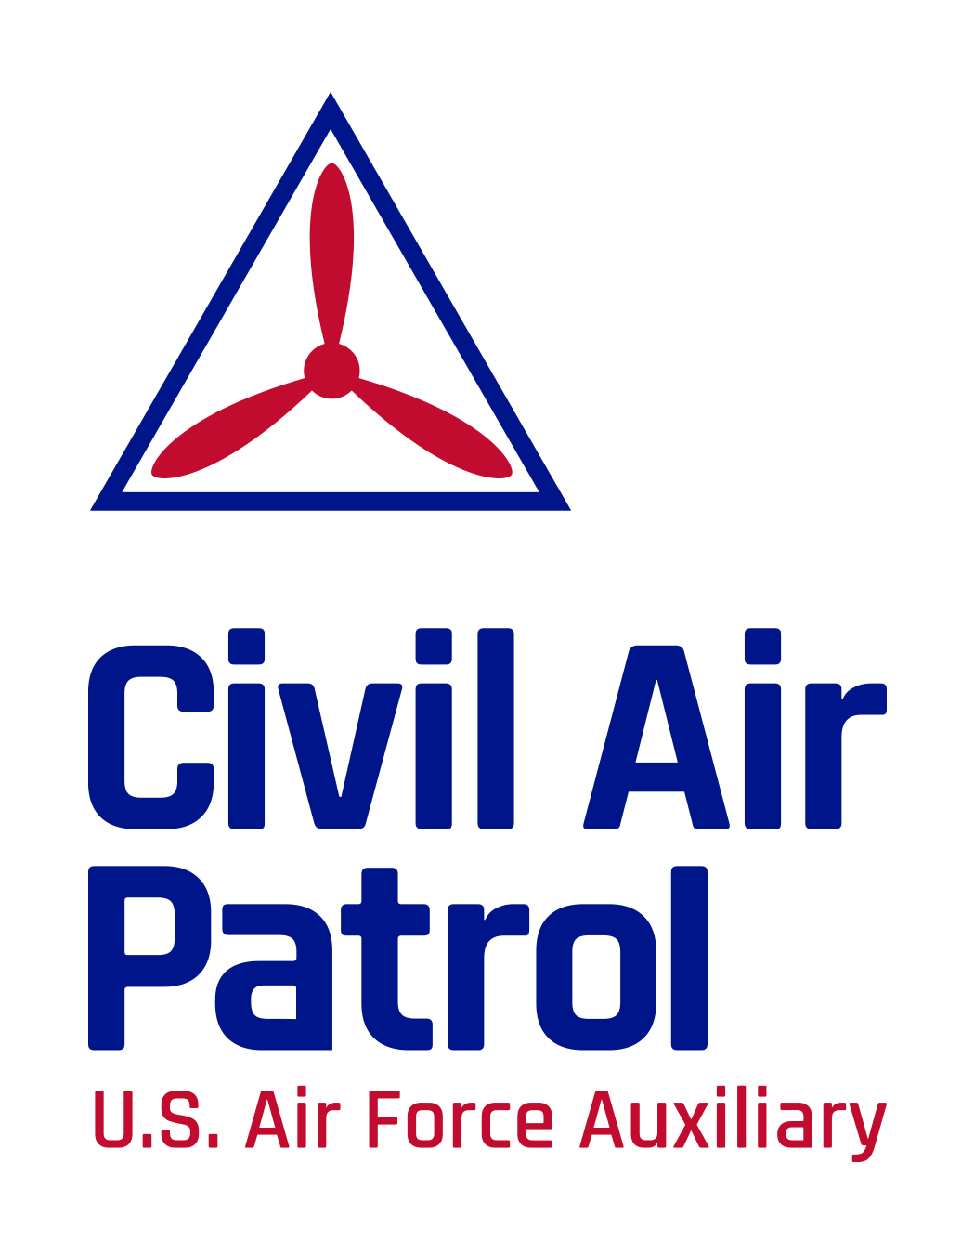
Visual Identity Timeline
An uncoupled logo reverts to the 1940s identity
1941-1952
1951-1966
1959-2012
2011-2012
2012- today
2019 - today
1
2
3
4
5
6
Efforts to refresh the identity over a span of 80 years haven’t fully captured the essence of an evolving organization — especially when uncoupled from the wordmark.
Notes:
Except for a shoulder patch between 1951-1966 and a strange logo deviation in 2011-2012, CAP hasn’t effectively shed the 1940s Civilian Defense identity despite the fact that Civil Defense hasn’t existed in decades.

Slide 10
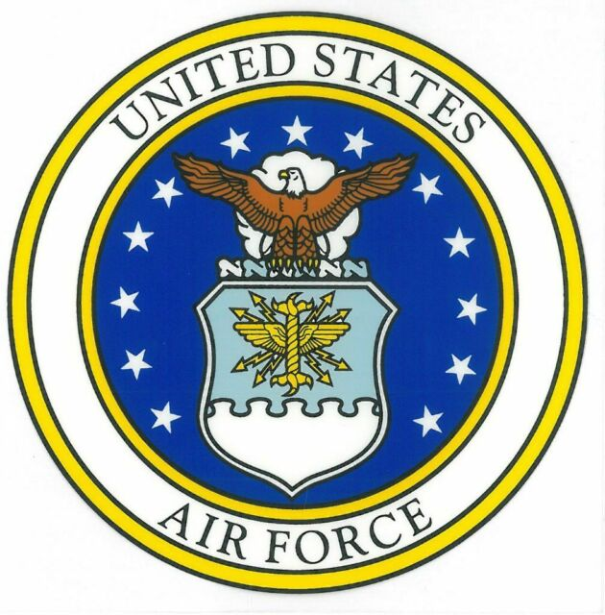
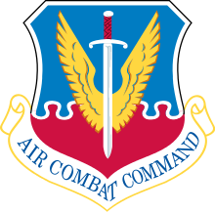
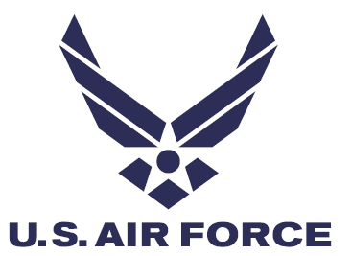

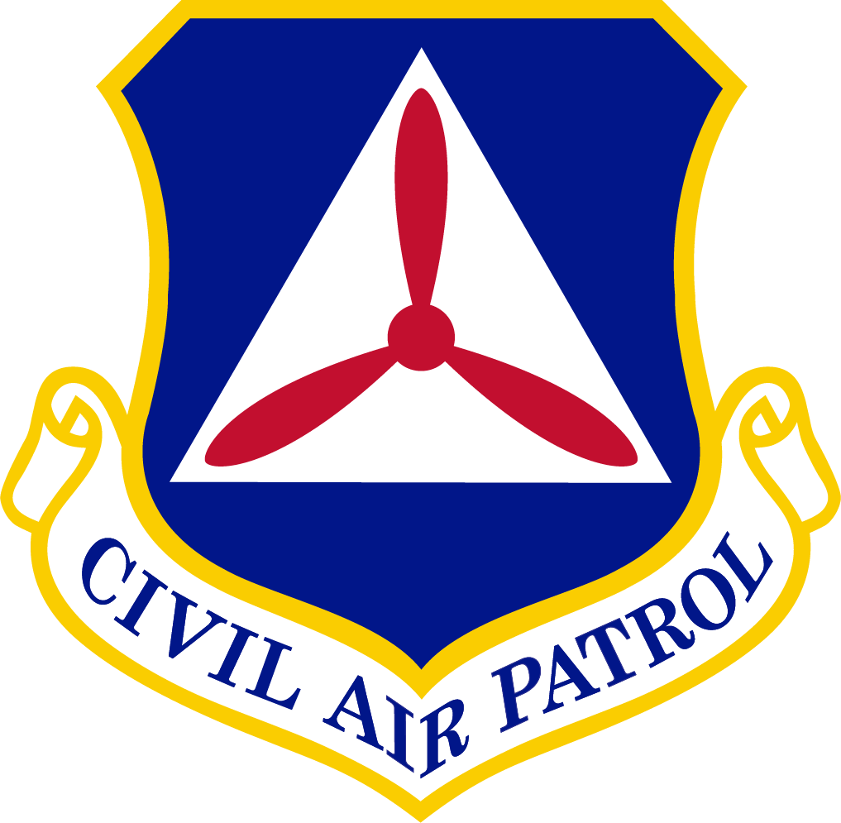

Scope of Refresh
Seal
Unchanged
Emblem
Unchanged
Logo
Updated
Notes:
How does a logo change impact the average member?
Probably very little. The uniforms don’t change, etc. because the command emblem is unchanged. There is no need to spend any money, etc.
What does it mean to the organization?
It shows that we’re looking to the future not focused on the past reliving the glory days of WWII. It shows that we’re not still linked with the Office of Civil Defense. It shows that we’re dynamic, evolving modern, hi-tech Total Force partner. It shows that we haven’t peaked and stagnated like many mature organizations do (think Lions, Kiwanas, Elks, Moose, Knights of Columbus, etc.). It shows change and progress.

Slide 11


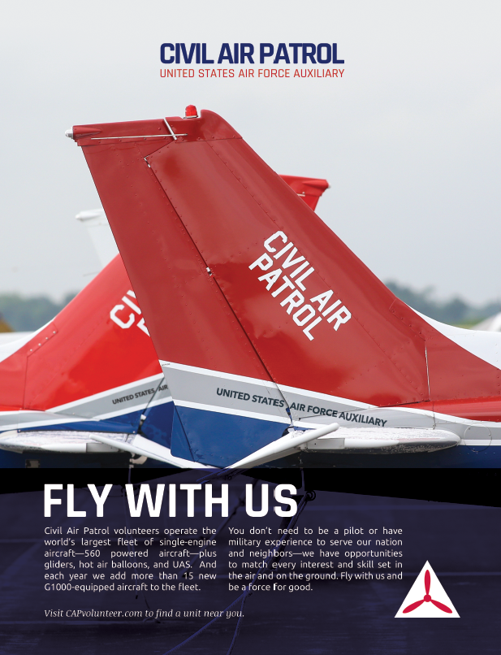
Associated Applications
Only the logo changes.
Command emblem and seal remain unchanged.
Notes:
Modernizing the logo while keeping the command emblem provides the best of both worlds from a rebrand perspective.
1) A modern logo for the corporate identity and
2) A legacy piece for nostalgia/heritage
As brand updates go, this is a win-win. We keep the old and get something new.

Slide 12
01
02
03
04
05
06
Current State:
Best Practice:
Rationale:
Readiness:
Case Studies:
Next Steps:
How we got here
Why brands modernize
Why CAP needs a refresh
What members think
How other companies manage
Where we go from here

Slide 13
Why Brands Modernize
02
Brands modernize because change is constant.
Missions change, technology advances, products and services evolve, and design trends shift.
Visual identities that stagnate give the impression that the company, product, or service is outmoded.
Modernizing a logo is a visual manifestation that reflects change.
Best Practice:
Notes:
AT&T doesn’t still go by American Telephone & Telegraph and their logo is now a globe, not an old-fashioned phone.

Slide 14
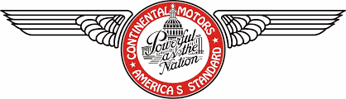
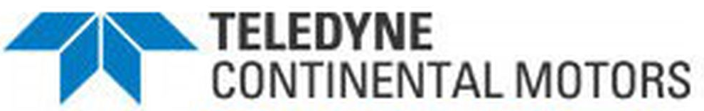

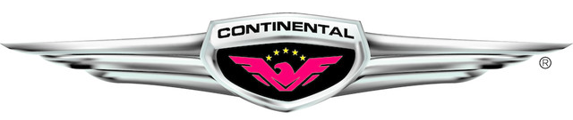
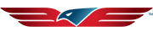
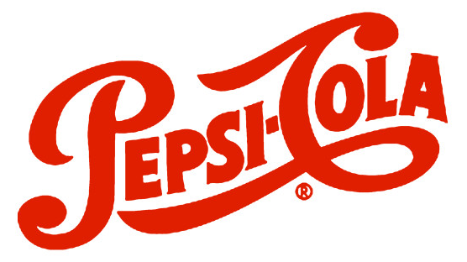
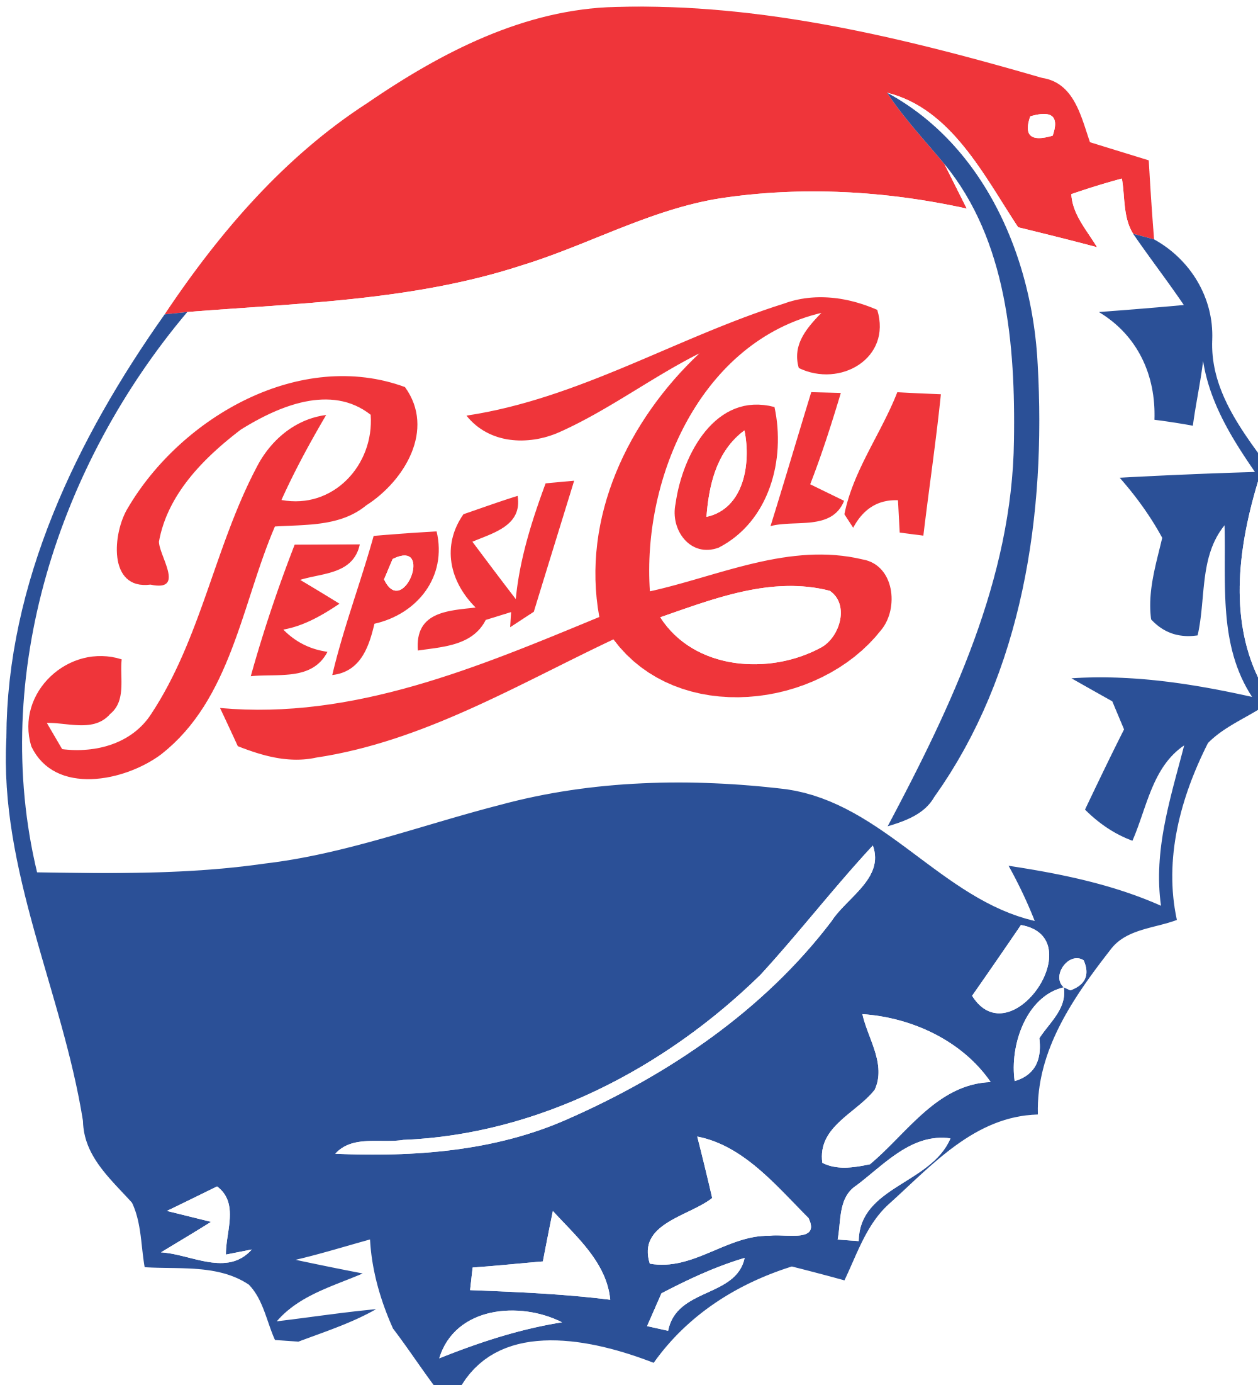
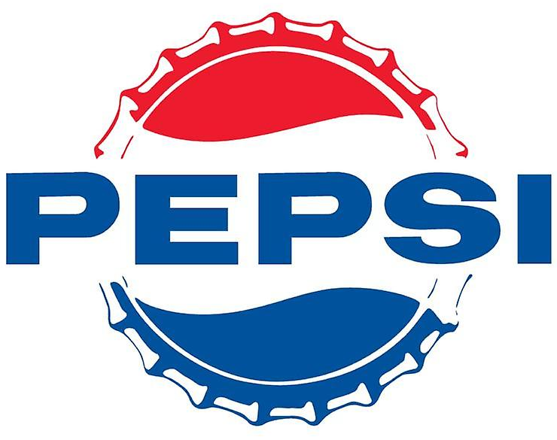
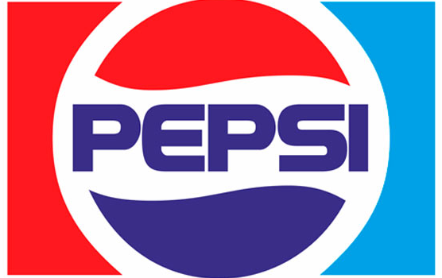
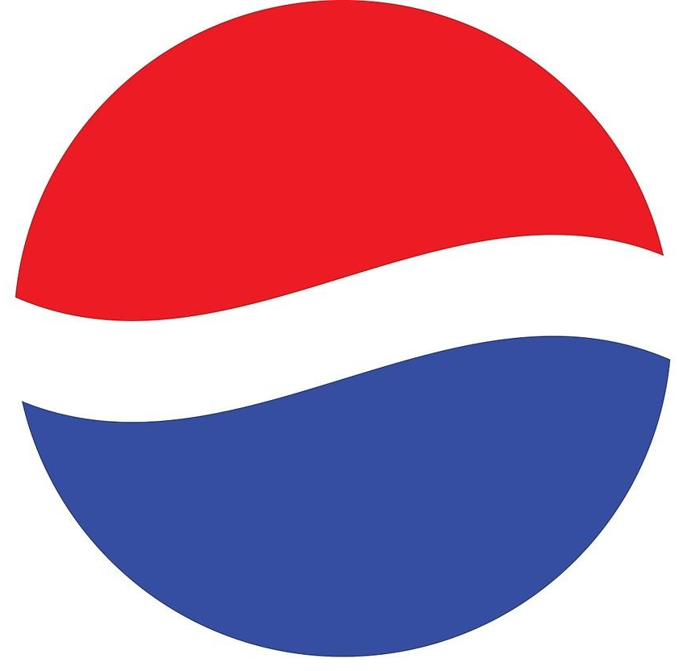

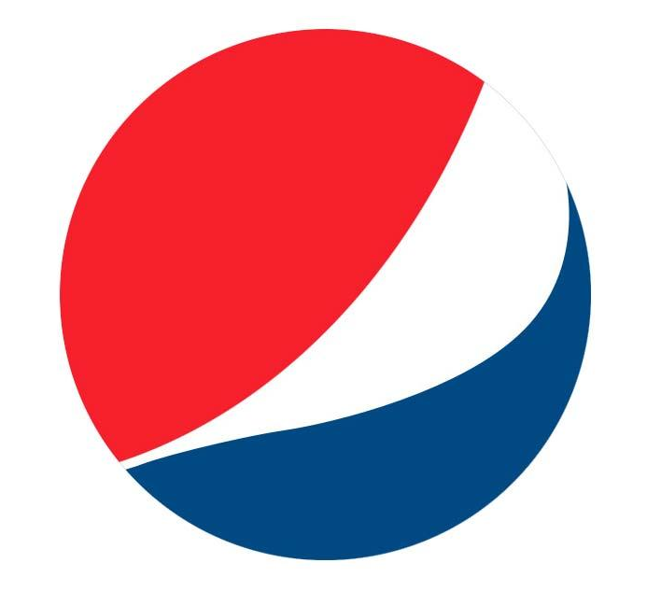
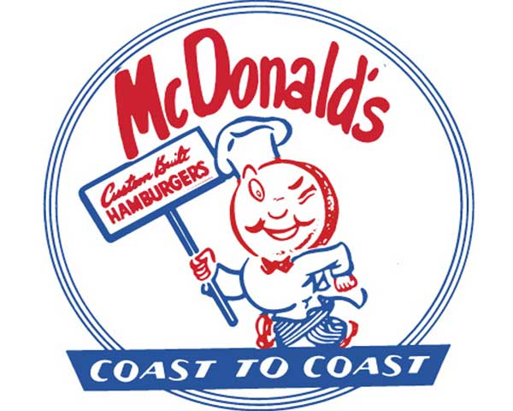








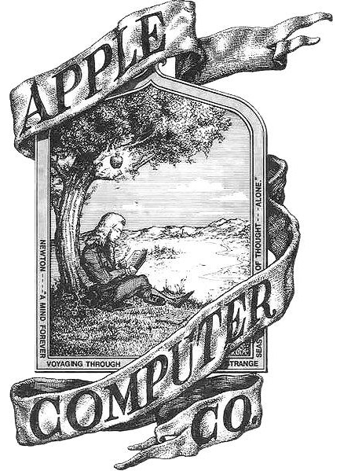







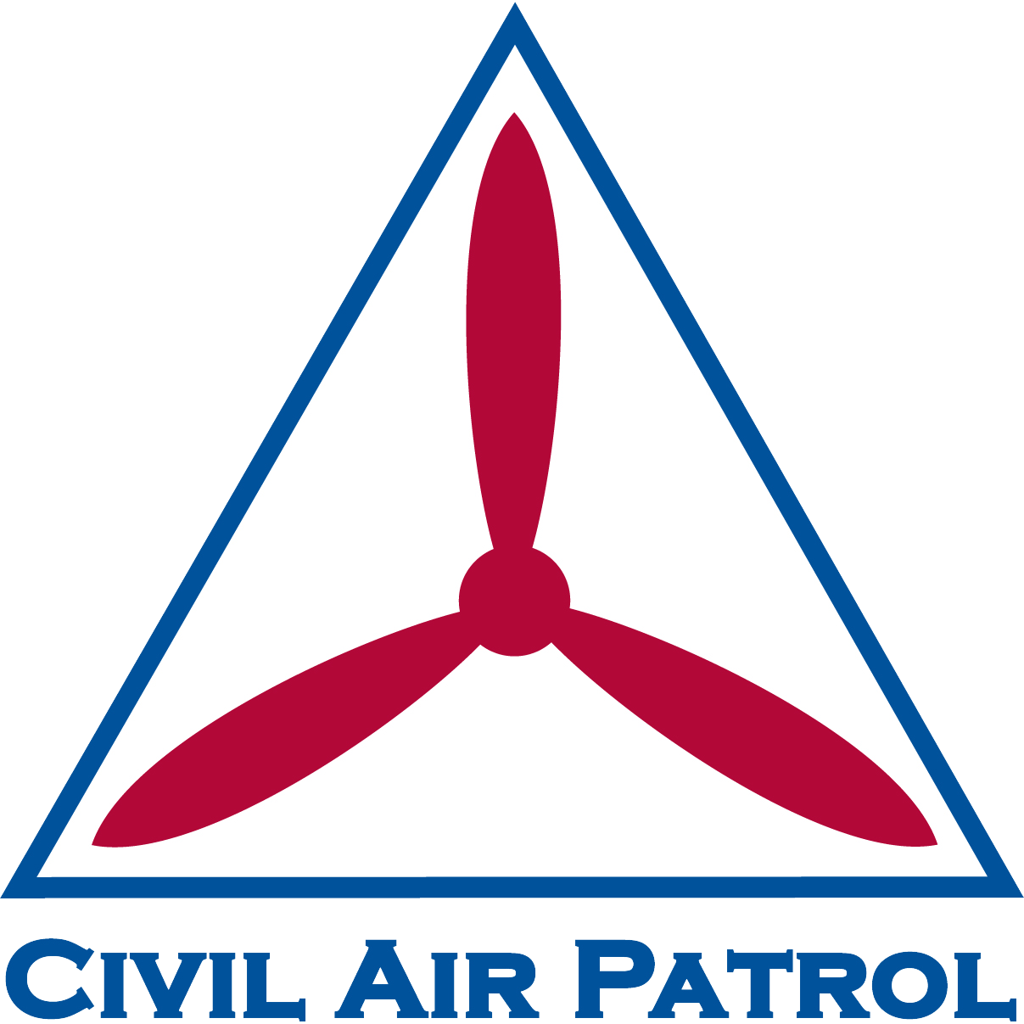


Sample Brand Modernization
Modernization
1940s 1950s 1960s 1970s 1980s 1990s 2000s 2010s 2020s
Indicates year of most recent brand refresh
Updating a logo periodically is a brand management best-practice that exhibits progress.
Stagnation
1941
US Army
Air Forces
1947
US Air Force
Notes:
The hallmark of good brand management is to grow, change, and evolve to remain relevant, generation after generation.
A logo associated with a WWII-era organization loses relevance with each new generation of youth. Updating a logo periodically is a brand management best practice the exhibits progress.

Slide 15
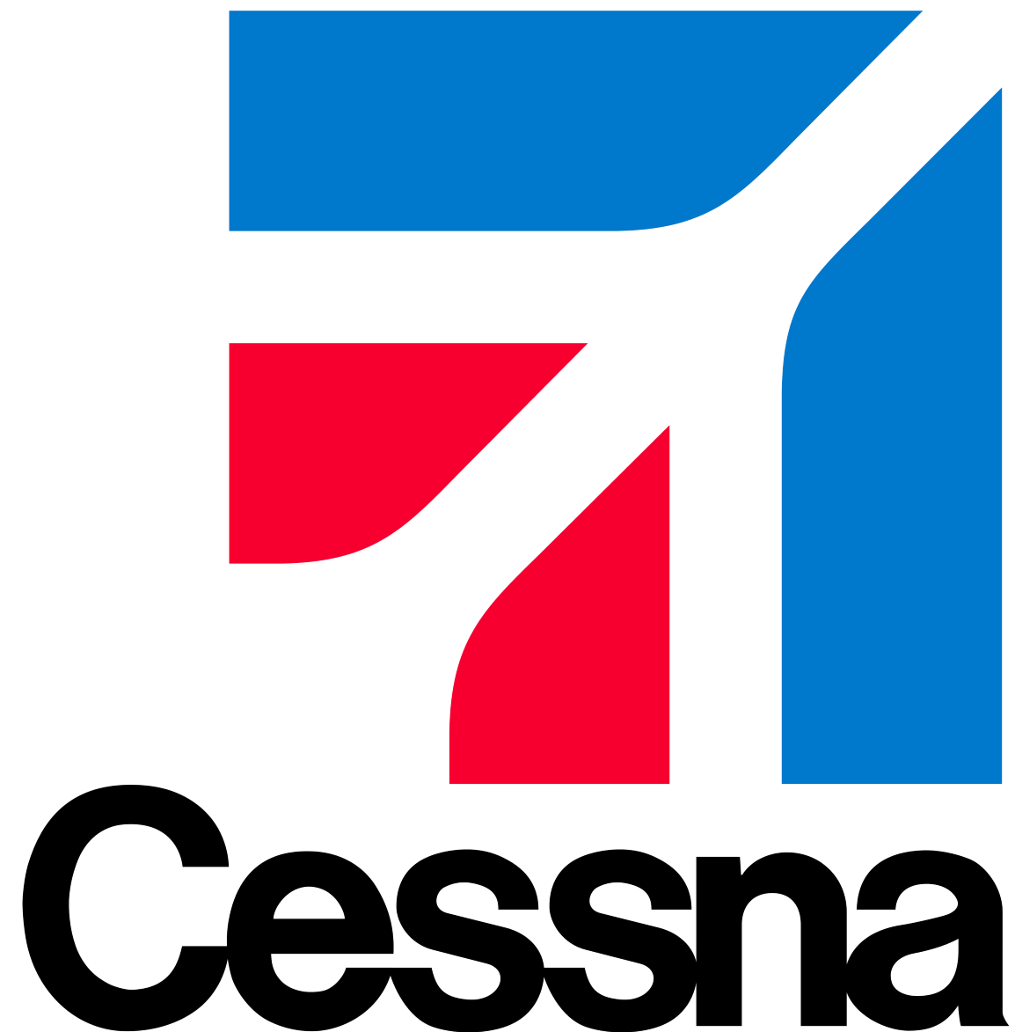
Changing Times
Brands that don’t evolve, lose relevance.
For example, the vintage Cessna logo (left) was appropriate branding on the tail of a circa 1940s Cessna 195. However, that same logo would create a brand disconnect in 2022 if used on the tail of a swept-wing .935 Mach-capable Citation X.
Circa 1947
2021

Slide 16

Remaining Relevant
Brands that don’t evolve, lose relevance.
In 2000, the Air Force updated its logo. The new shape reflects a modern air force more than a bygone age of Army aviation.
Circa 1940
Today
Without Civil Defense, the CAP logo has lost its point of reference. Consequently, each new generation is further removed from the relevance of a WWII-era visual identity because there is no emotional connection.
Notes:
Understanding brand psychology and the physiology of how humans absorb information visually and make subconscious assessments, CAP needs to modernize the logo. We’re not our grandmother’s CAP anymore.

Slide 17
01
02
03
04
05
06
Current State:
Best Practice:
Rationale:
Readiness:
Case Studies:
Next Steps:
How we got here
Why brands modernize
Why CAP needs a refresh
What members think
How other companies managed
Where we go from here

Slide 18
Why CAP Needs a Refresh
03
In order to promote Civil Air Patrol as a high-tech company that adapts, adopts, and develops technology, the visual identity needs to migrate to the 21st Century to match the technology the organization uses.
Rationale:

Slide 19
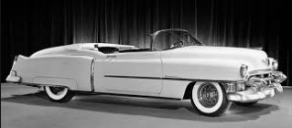
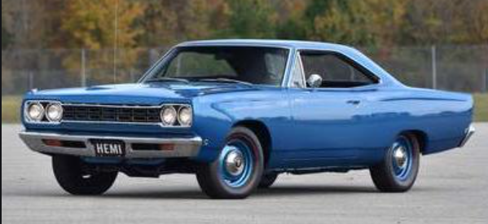
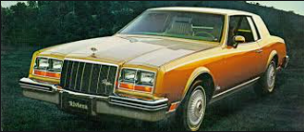

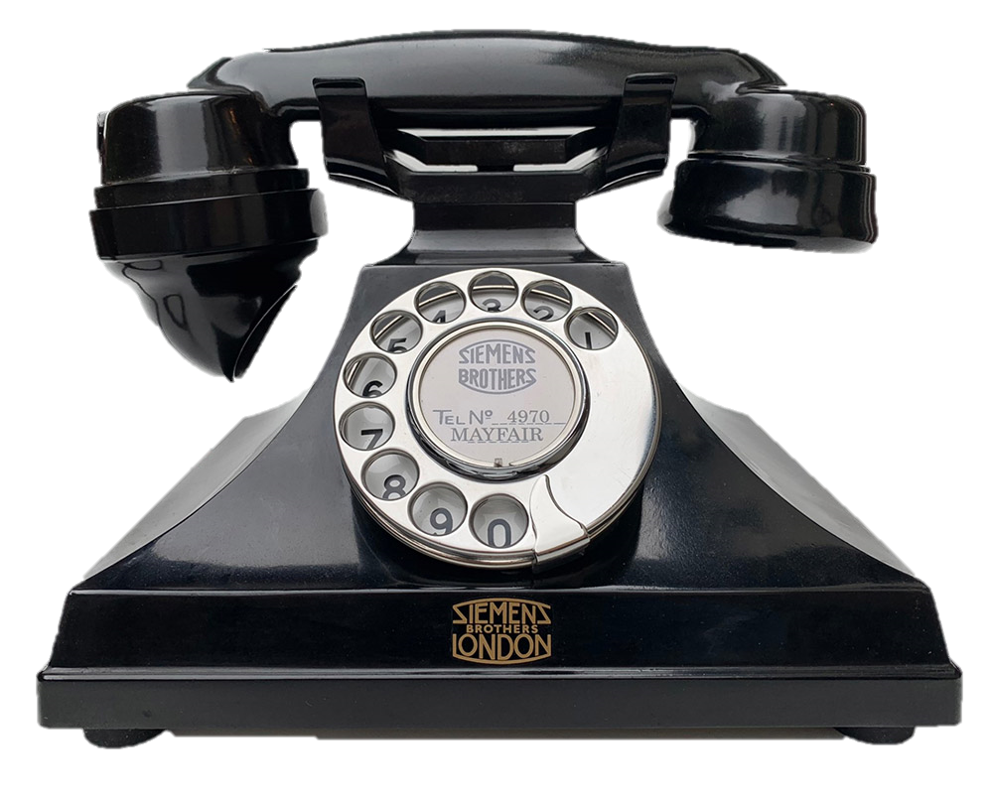


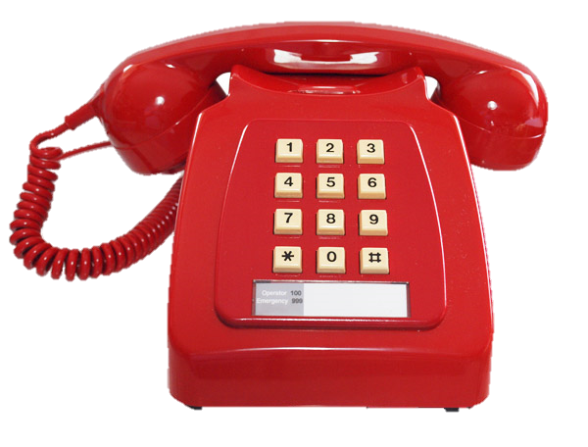
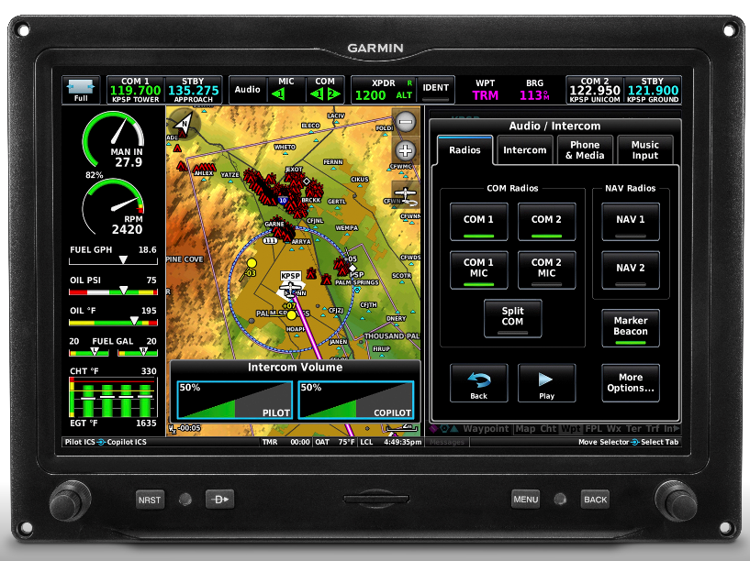
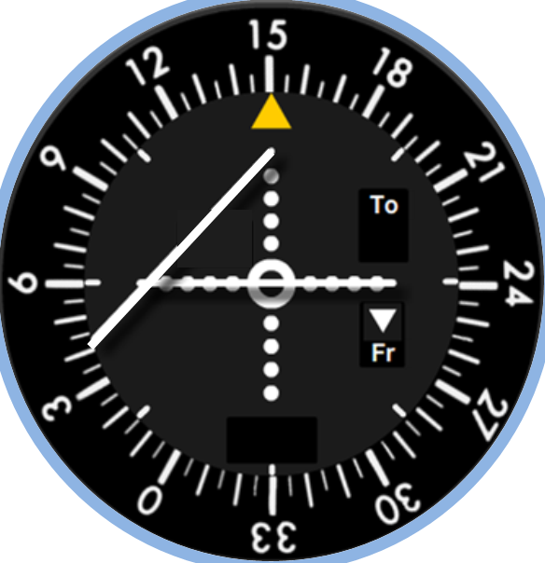
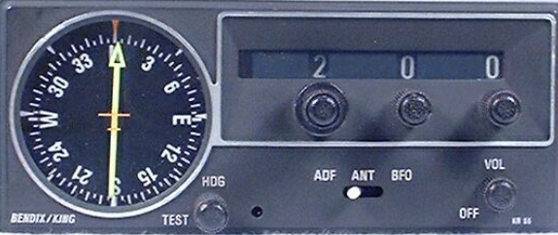
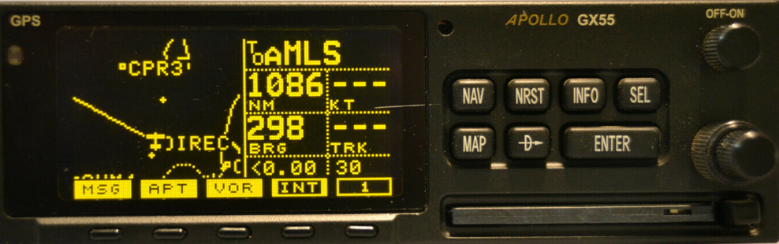
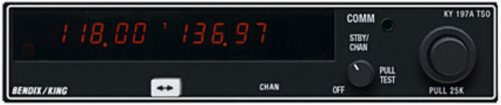

Eight Decades of Modernization
Modernization
1941-1959
1960-1979
1980-1999
2000-2020
Cruiser
Muscle
Luxury
Electric
Mobile
Rotary
Touchtone
Cordless
MFD
ADF
VOR
GPS
Stagnation
Notes:
Cars, technology, avionics, etc. have evolved considerably in 80 years.
CAP’s identity hasn’t left the barn. By default, we’re telling the nation, donors, stakeholders, prospective new members, etc. that we’re the same organization we were in the days of Civilian Defense.

Slide 20
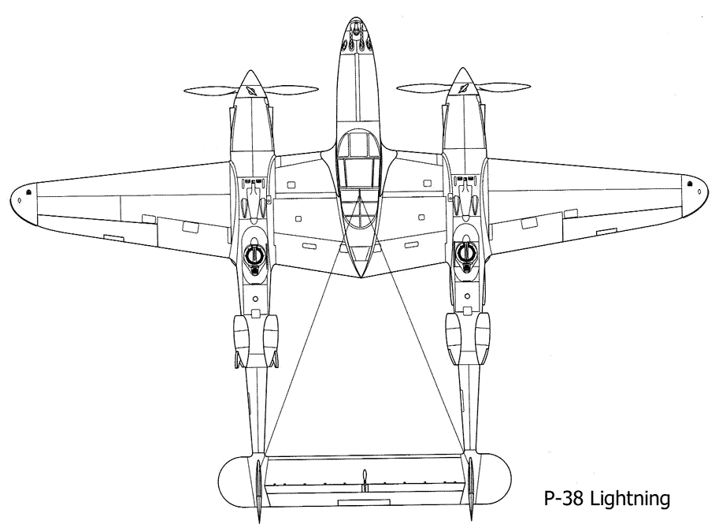
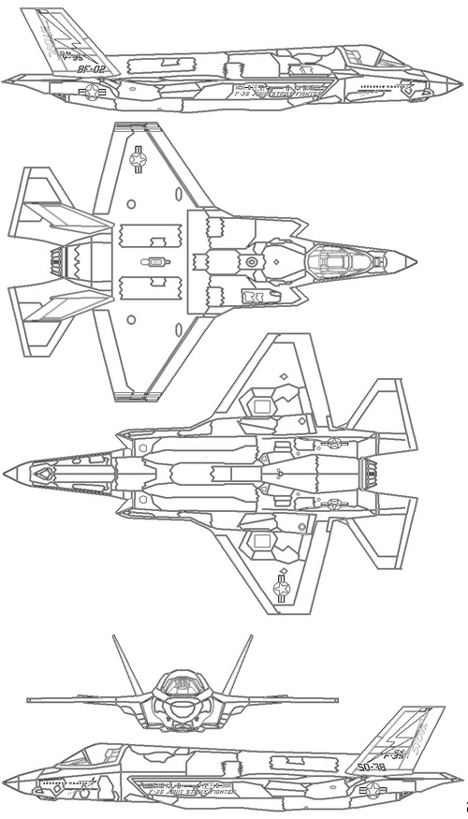

AF Modernization
Current logo reflects the current technology.
P-38 Lightning Circa 1940s
F-35 Lightning II
Circa 2020s
Top Speed: 443
Top Speed: 1,199
Notes:
The new USAF logo reflects the evolution of technology – even its stealthy shape is sleek and fast.

Slide 21








CAP Modernization
Current logo does not reflect current technology.
20th Century Search Techniques:
Expanding Square
Contour Search
Sector Search
Parallel Track
Route Search
Creeping Line
21st Century Search Techniques:
Cellphone Forensics
Radar Analysis
GPS Coordinates:
LAT: N 25-43
LON: W 76-38
Search Time:
Measured in Hours
Search Time:
Measured in Minutes
Notes:
The CAP logo does not reflect the quantum leap in technology since the 1940s

Slide 22
01
02
03
04
05
06
Current State:
Best Practice:
Rationale:
Readiness:
Case Studies:
Next Steps:
How we got here
Why brands modernize
Why CAP needs a refresh
What members think
How other companies managed
Where we go from here

Slide 23
What Members Think
04
Since first being mentioned at 2020 Winter Command Council, a brand refresh has been discussed among various groups large and small.
Various formal and informal polls validate the readiness of members to modernize the visual identity.
Readiness:

Slide 24


Survey Results
Since mid-2020, members have been surveyed and polled at multiple focus groups, wing conferences, and presentations about the idea of modernizing the logo.
54%
14%
“It's time to refresh the logo to something more modern like the Air Force.”
“I like the current logo.
The vintage look keeps us connected with our 1940s Civilian Defense heritage.”
81% WANT CHANGE
27%
5%
“I'd like to see a bold new logo.
CAP is very different today and our logo should reflect that.”
“I'm not certain which one of the CAP graphics is the official logo.”
Notes:
The data is a compilation of all surveys and polls over the past two years.
Much like a technology adoption curve, a brand refresh includes Innovators, Early Adopters, Early Majority, Late Majority, and Laggards
Studies show that the Late Adopters will be reduced by more than half when shown an alternative new logo. They just may not be able to envision what that new shape might looks like or understand the need to change. And some members may grow to like it over time (as was the case with the new Air Force logo) and some may never like the new logo for a variety of reasons (emotional attachment to the old logo as a cadet, aesthetics, color, etc.). However, laggards and late adopters ho resist changes are not the visionaries whose voices drive an organization forward – innovators and early adopters drive change and growth within organizations.

Slide 25
01
02
03
04
05
06
Current State:
Best Practice:
Rationale:
Readiness:
Case Studies:
Next Steps:
How we got here
Why brands modernize
Why CAP needs a refresh
What members think
How other companies manage
Where we go from here

Slide 26
How Companies Manage
05
Brand modernization occurs on a continuum from gradual evolution to a complete redesign.
Whether the visual identity changes or not, it’s still making a statement – intentional or not.
The objective is to keep the logo aligned with desired reaction not the default perception.
Case Studies:

Slide 27




Refresh Continuum
2010 2011
1976 1977
Subtle logo changes that evolve organically tend to convey consistency and quality that consumers demand in specific products and services categories. Organic logos refresh more frequently.
Dramatic logo redesigns reflect boldness, innovation, or positive change that consumers expect in specific categories. This is more of a brand revolution than evolution.
Notes:
Since the CAP logo hasn’t kept pace with the world around us, any logo refresh that attempts to make up for 80 years of stagnation will seem more dramatic (like a revolution than an evolution).
To keep the logo unchanged however is to continue to visually relive the WWII Civil Defense glory days and ignore our role as a modern Total Force Partner.

Slide 28






Corvette Case Study
Since 1953, each Corvette redesign included an identity refresh.
Yet, whether literal or abstract, every badge iteration reflects its heritage of the crossed checkered and bowtie flags with fleur-de-lis.

Slide 29

USAF Case Study
In 2000, the Air Force modernized its visual identity to what is today a more accurate representation of a 21st Century air force advancing into the future.
Circa 1940
Circa 2000
Today
In 2000, Civil Air Patrol was still visually reliving the glory days of the 20th Century, mired in the past as the world around us marches forward.
Notes:
Realizing the psychology of branding and the physiology of how humans absorb information visually and make subconscious assessments, the Air Force modernized the logo at the turn of the century – more than 20 years ago.
By comparison, the antiquated CAP logo makes the company feel dated compared to the Air Force.

Slide 30


Air Force Rebrand Scorecard
Retains heritage (star and globe)
Simplified design (one color)
Increased flexibility (no container)
More modern than retro
Enhanced visual appeal
Modern design aesthetic
More closely represents today’s organization than yesterday

Slide 31



Logos Shape Perception
Colonial Pipeline’s branding is a disaster. That should’ve been a warning sign.
Civil Air Patrol’s branding is a disaster. That should’ve been a warning sign.
| 5-21-2021
Elements of branding, particularly those that are most obvious, such as names and logos, are often belittled as facades or window dressing. But a brand’s appearance can actually be a keen indicator of the nature of the firm it represents.
It’s clear that over the course of the cyber-attack and its aftermath, their timeworn brand has told us all we need to know about this company.
Like the company’s name, its 1962 logo has remained unchanged. A classic, clean, and clever midcentury trademark design, it displays the CP initials within a cross-sectional view of a pipeline. Perhaps it’s a cousin of the old Civil Defense insignia.
Because Colonial Pipeline continued to operate largely outside of the public eye, it probably felt little pressure to update its branding over the years.
Notes:
Let’s not let this happen to Civil Air Patrol on our watch.

Slide 32
Here’s the Question:
Should CAP remain connected to the WWII past?
Could CAP be better positioned
for the future?
OR
1941 -- 2022
2000 - 2022 -
Civil Defense Icon
Civil Air Patrol Logo
U.S. Air Force Logo
CAP/Air Force Auxiliary Logo
Office of Civilian Defense dissolved 1979
Total Force partnership
established 2015
Notes:
Should CAP get our collective brand identity from the glory days of WWII?
Or is CAP a hi-tech company whose missions and technology continuously evolve to meet the needs of today?
What does the logo say about CAP – living in the past or looking to the future?

Slide 33
01
02
03
04
05
06
Current State:
Best Practice:
Rationale:
Readiness:
Case Studies:
Next Steps:
How we got here
Why brands modernize
Why CAP needs a refresh
What members think
How other companies manage
Where we go from here

Slide 34
Where We Go From Here
06
Modernization objectives:
Update the logo to reflect a dynamic 21st century company.
Improve visual appeal and flexibility.
Shape the desired perception rather than settle for the default assumption of CAP.
Retain CAP’s heritage.
Next Steps:

Slide 35







This is the family Civil Air Patrol should fit into.

Slide 36



Concept Inspiration
Volunteers serving America’s communities, saving lives, and shaping futures.
‹#›
Notes:
Inspiration for the new logo shape came from a familiar CAP shapes.
There are other nonprofits in the emergency services, humanitarian relief, education/STEM, and youth programs. The thing that sets CAP apart is the fact the we operate the worlds largest fleet of aircraft. The aircraft provides a source of inspiration.

Slide 37




Logo Brand Story
1
Aviation
2
Volunteerism
Aviation differentiates CAP from other nonprofits in youth development, emergency services, and education.
Volunteerism fuels CAP which is why “Volunteers” is the first word in the mission statement.
3
Partnership
Color and aesthetic cues visually align CAP as a Total Force partner of today’s modern Air Force.
5
Programs
4
Heritage
Bars divide in the wing shape into thirds to represent three CAP programs.
Triangle and bars in the negative space celebrate the heritage of CAP’s Civil Defense roots.

Slide 38




















Everything Looks Like Something
1A
B
5A
B
2A
B
6A
B
3A
B
7A
B
4A
B
‹#›
Notes:
Everything looks like something. Winged logo are common in aviation, auto, logistics and delivery, apparel, etc. MAC has already done a trademark sweep on the proposed new logo. The 383-page reports shows that there will be no issues for CAP to trademark to proposed new logo.
1AB Citgo Delta
2AB Oldsmobile Infiniti
3AB Washington Nationals Walgreen’s
4AB Coach Wells-Fargo
5AB Guggi Channel
6AB Columbia Sun Microsystems
7AB Xbox Xerox

Slide 39

LOCK-UPS
CIVIL AIR PATROL
U.S. AIR FORCE AUXILIARY
CIVIL AIR
PATROL
[horizontal]
[sans USAF]
CIVIL
AIR
PATROL
CIVIL AIR PATROL
U.S. AIR FORCE AUXILIARY
U.S. AIR FORCE AUXILIARY
[vertical]
[hipster]

Slide 40


All Caps Balanced Lock-ups
CIVIL
AIR
A
A
PATROL
Notes:
Updating the wordmark (all caps and length to match “Civil Air Patrol” also provides an opportunity to solve some problem areas with the existing logo and equity between CAP and USAF Auxiliary.

Slide 41


Focus Group Word Clouds
Notes:
What the visual identity says about our organization based on surveys and polls are various presentations.

Slide 42


Modern, single color design comparable to USAF
Floats without a container for more flexibility
Lock-up is more purposeful
While not the same character size, both names have equal length
Wordmark is all caps like the six branches of military
CIVIL AIR PATROL
U.S. AIR FORCE AUXILIARY
CIVIL AIR PATROL

Slide 43
CAP Rebrand Scorecard
Retains heritage (Civil Defense triangle)
Simplified design (single color vs. three)
Increased flexibility (no container)
More modern than retro
Enhanced visual appeal
Modern design aesthetic
More closely represents today’s organization than yesterday’s

Slide 44

CIVIL
AIR
PATROL

Slide 45




Air Force-Related Logo Family
CIVIL AIR PATROL
U.S. AIR FORCE AUXILIARY
Total Force
Civilian

Slide 46
Here’s the Question:
Will Civil Air Patrol remain associated with the defunct Office of Civilian Defense of the past?
Will CAP leverage the association as an Air Force Total Force partner for the future?
OR
1941 -- 2022
2000 - 2022 -
Civil Defense Icon
Civil Air Patrol Logo
U.S. Air Force Logo
CAP / USAF Auxiliary Logo

Slide 47

The Result
Seal
Unchanged
Emblem
Unchanged
Logo
Updated

Slide 48


END
Notes:
Leaving the past behind…

