Slide 1

Navigating the Digital Landscape
Maintaining an online presence for Squadrons, Groups, and Wings
Captain Roman Vitanza
CAP Brand Manager and Public Relations Specialist

Slide 2

Social Media Governance

Slide 3
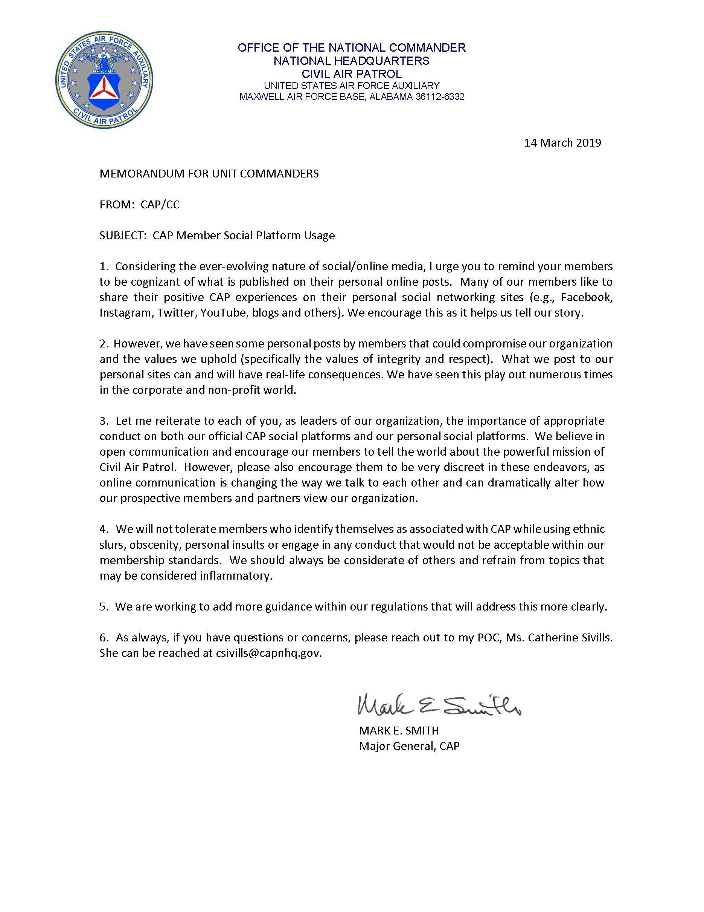
From Maj Gen
Mark Smith
We encourage you to tell our CAP story.
Some member’s personal posts compromise our values – specifically integrity and respect.
Use appropriate conduct on both official and personal social media platforms.
Do not associate yourself with CAP on your personal social profiles when talking about inflammatory topics.
More guidance within our regulation's forthcoming.

Slide 4
Social Media in CAP Regulations
CAPR 190-1, CAP Public Affairs Program (16 November 2016)
11.2. Social Media.
Summary: Units PAOs oversee all official social media channels. “The responsibility for use of social media by CAP units rests with the unit commander and it will be overseen by the unit PAO or a member designated by the commander under the direction of the unit PAO.”
11.3. Social Engagement.
Summary: Members are encouraged to share their positive CAP experiences and accomplishments on their personal social media accounts.

Slide 5
Social Media in CAP Regulations
CAPR 120-1, Information Technology Security (1 October 2017)
5.4. Public Affairs Information.
Summary: This says that members cannot use CAP Internet Operations to disseminate public information and that guidelines for using CAP-owned resources are in CAPR 190-1, which it is not.
  “CAP members shall not use CAP Internet Operations to disseminate information that would normally be distributed through public affairs officers without commander or the releasing PAO’s approval.”

Slide 6
Digital Landscape

Slide 7

New Directorate
Chief of Marketing & Strategic Communications:
Randy Bolinger
Deputy Chief:
Rick Pallister
Notes:
With a new focus on marketing and the future of the organization, national headquarters recognized it not only needed a new team, but a whole new direction.
That team’s origins began with hiring two visionaries with proven track records across multiple industries to lead the new directorate.

Slide 8
Strategic Plan Focus
“consistent brand voice”
“unified ‘One CAP’ look and feel”
Two Overarching Objectives
Digital Transformation
Marketing and Partnerships
2022-2026 STRATEGIC PLAN
“brand identity”
“consistency promotes professionalism”
Notes:
With a new directorate and a team beginning to form, the national Strategic Plan pointed us to the future with a resonating theme, “a consistent brand voice.”
But we needed the team first to make this happen.

Slide 9
Discovery
What does your current scope’s online presence consist of?
What information is already out on the Internet about your scope and your members?
What images could the public find regarding your scope?
What’s the general opinion on your organization and membership?
How do we find all this information out?

Slide 10
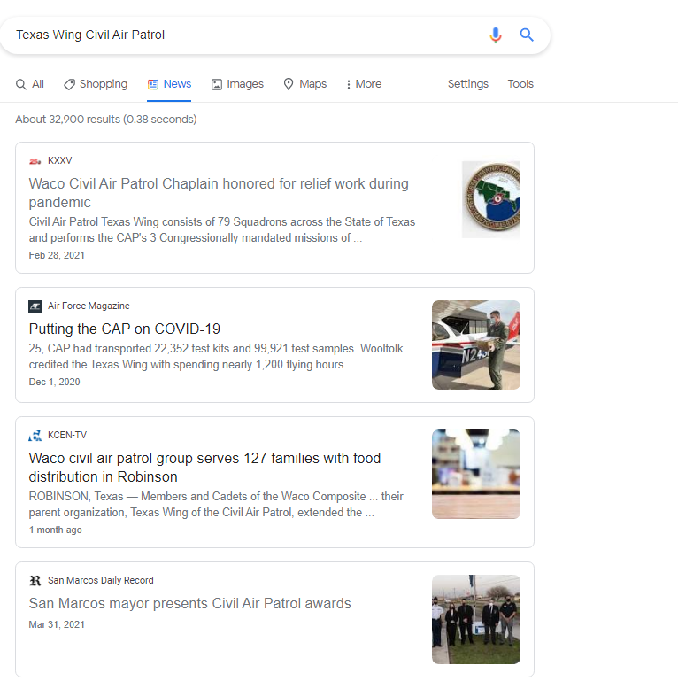
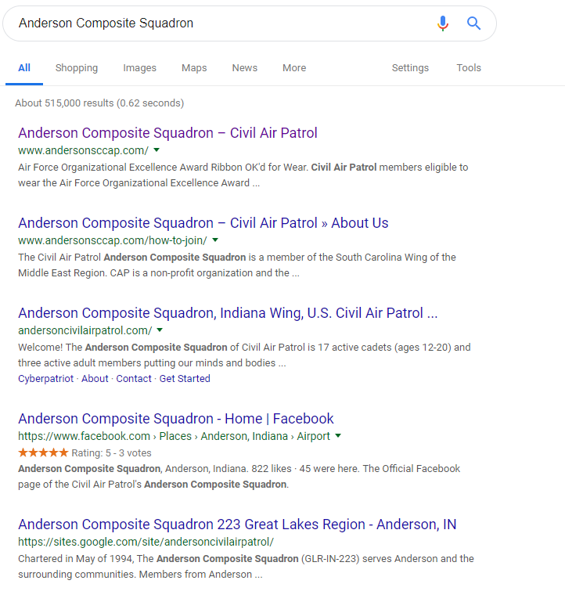
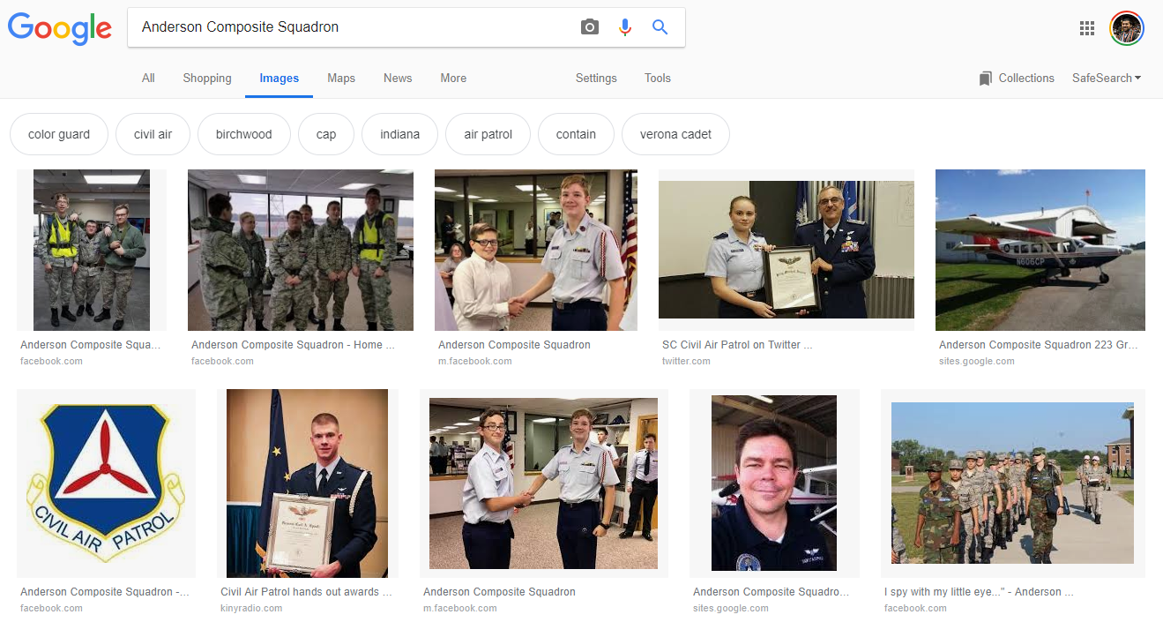
Google Yourself!

Slide 11

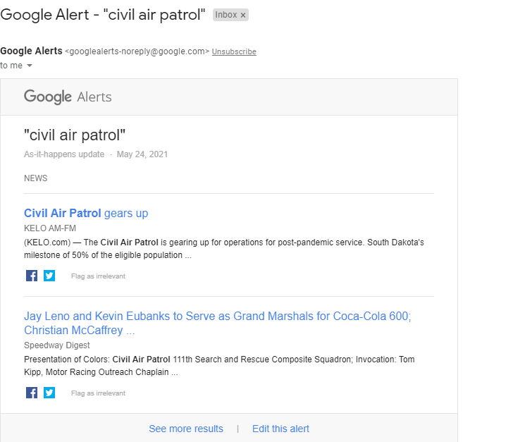
Google Alerts for Keywords

Slide 12
Discovery
The most important part of discovery, is making sure your online reputation is exactly what you want it to be.
Keep an eye on your social media presence.
Discover anything negative, unflattering, or potentially harmful information.
REPORT IT TO YOUR HIGHER AUTHORITY
On Social Media channels, it’s best to:
Remove unflattering profile information.
Delete hastily written comments.
Restrict through privacy settings.
Think before it goes live “Hey do I want this out there”.
REPORT THINGS TO A HIGHER AUTHORITY

Slide 13
Carefully Consistent Curated Content
The most important part of any social media presence or website is the content.
Nobody is going to take their own time to navigate to an unwelcoming, blank, all white, unorganized website.
Have something that could be easily shown across multiple platforms:
  Cell phone
  Tablets
  Laptop
Make content on the appropriate platform for the appropriate group you are trying to reach
Ask yourself the question “Does this type of content fit this platform?”

Slide 14
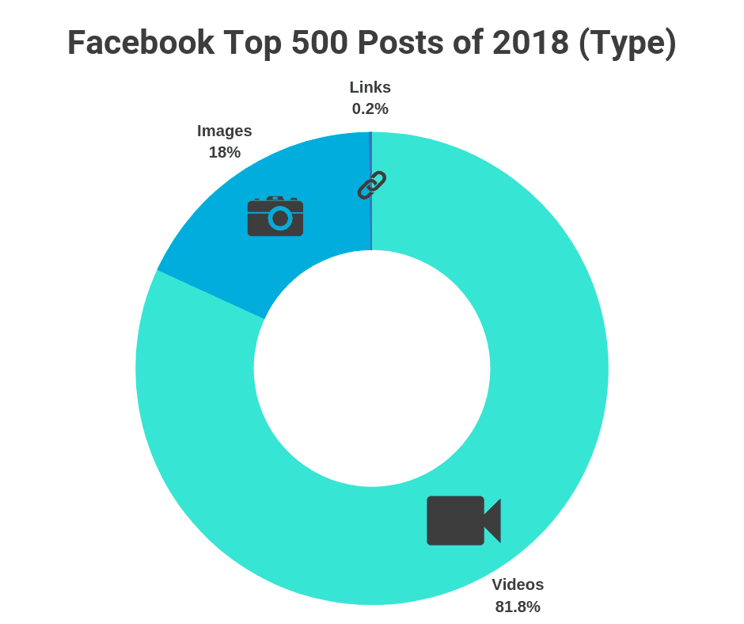
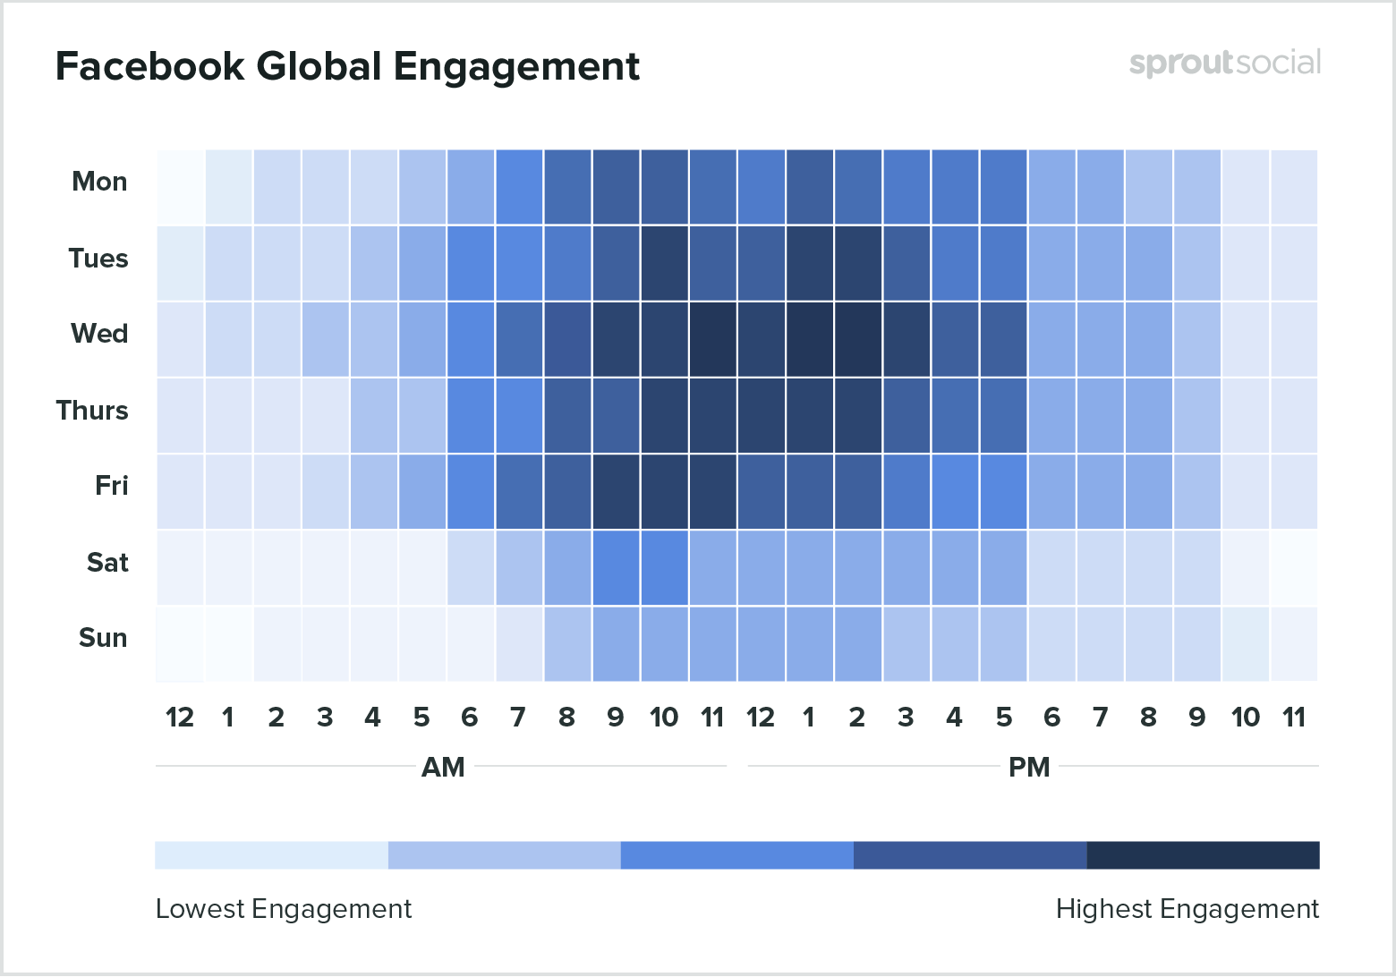
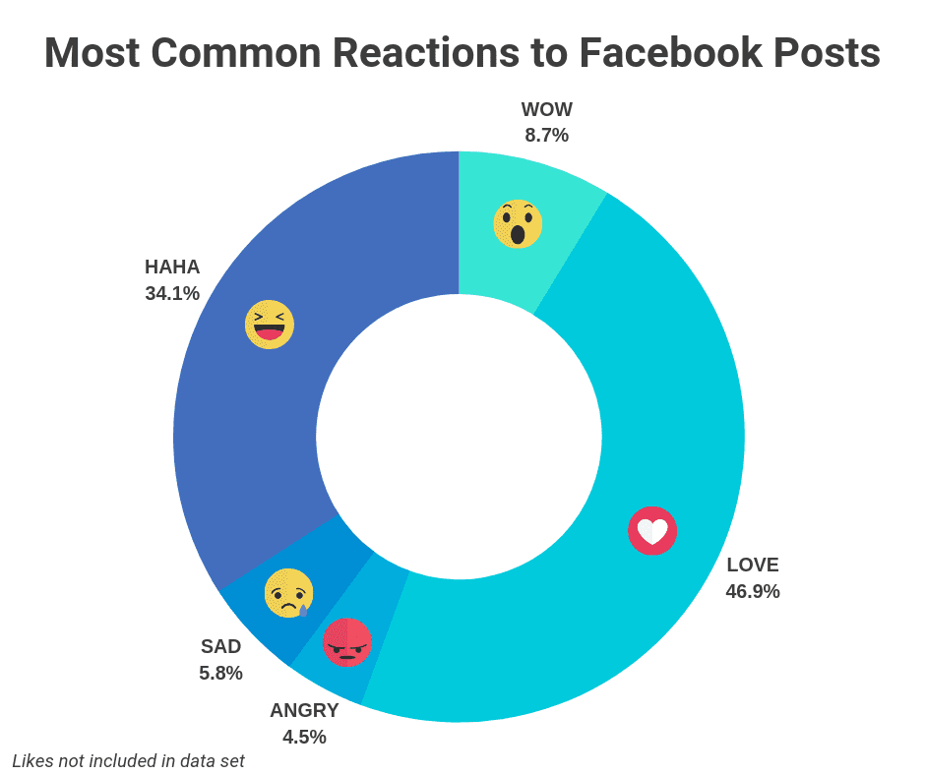
Carefully Consistent Curated Content
Facebook
  What Works
    Video Performs better than all other types of Facebook post
    The most common reactions to top Facebook post are LOVE and HAHA
    Inspirational, funny, or practical content generates the most engagement
  What doesn’t work
    Long bodies of text with no media content
    Posting emails as status updates
    Not knowing your target audience

Slide 15
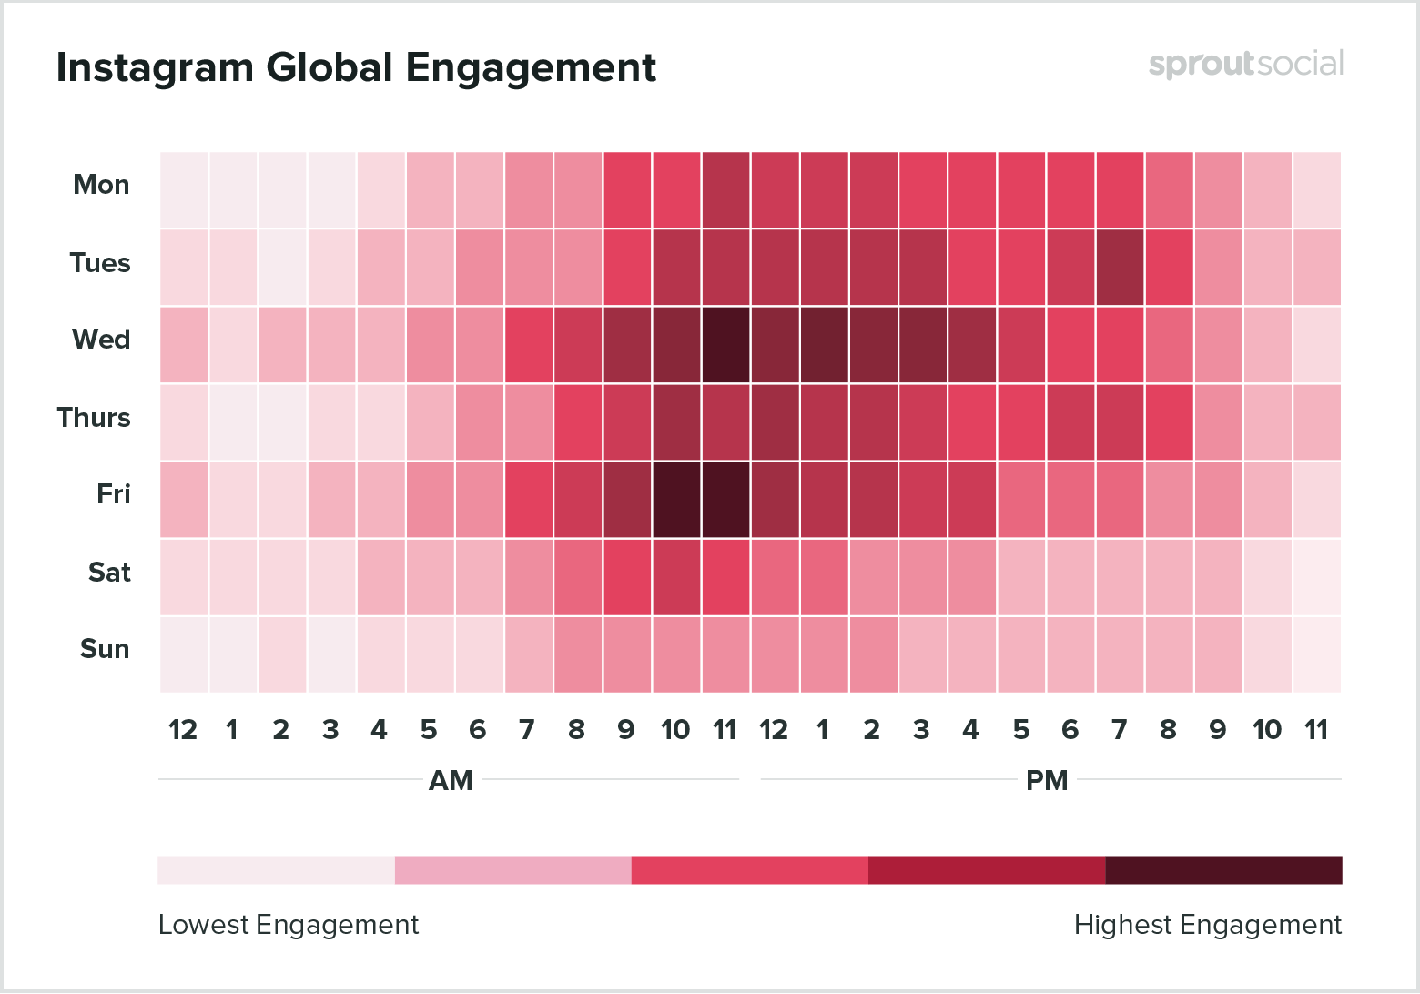
Carefully Consistent Curated Content
Instagram
What Works
    Post engaging, high-quality images
    Know what your audience wants
    Tell visual stories with hashtags and data-driven decisions
  What doesn’t work
    Don’t post without captions
    Don’t ignore your follows
    Don’t overuse or misuse hashtags

Slide 16
Carefully Consistent Curated Content
Over 3,000,000,000 people use social media each month – 42% of the total global population.
Every second, 11 people are using social media for the first time.
Mobile share of web traffic has increased by 4% while desktop’s share has decreased by 3%.
Mobile apps account for 70% of time spent on social media networks.
People use mobile apps 7 times longer than mobile web browsers.
The networks with the most penetration among social media users in 2018 were Facebook, Instagram, and Snapchat.
Facebook still has the most app usage in the US, but only growing among users ages 65 and older.
Instagram is growing the fastest.
Pew Research, Omnicore, Statistic Brain, eMarketer

Slide 17
Carefully Consistent Curated Content
Useful Strategies for content creation:
  Use domain names and vanity URLs
  Use the same username on ALL social media sites
  Use the same/similar bio on all sites
  Use the same avatar/profile image on all sites.
  Cross-link your profiles across all channels.
  Make sure your social media account and website shows some sort of personality, but don’t overshare information.
  USE YOUR PRIVACY SETTINGS.
  Ask a local professional to perform a usability test on your website

Slide 18
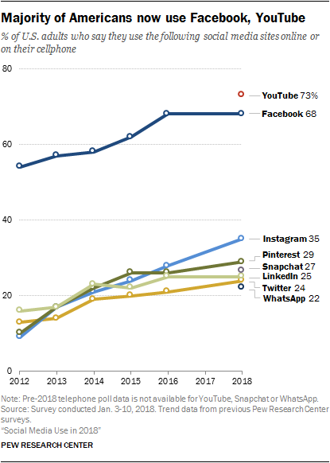
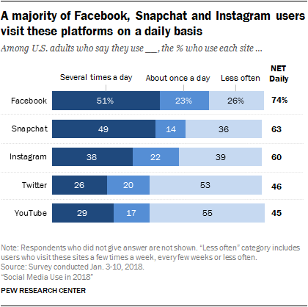
Carefully Consistent Curated Content

Slide 19



Creating Content

Slide 20
Creating Content
The Elevator Pitch
  A brief, persuasive speech that you can use to spark interest in what your organization does.
  Should last no longer than a short elevator ride of 20-30 seconds.
  Should be interesting and memorable, and still explain what makes your organization unique.
Identify your goals
  Start by thinking about the objective of your pitch. Do you want to tell potential new members about your organization? Do you have marketing opportunity?
Explain what you do
  Start your pitch by describing what your organization does, how you help people, and what you have accomplished as a team.
What makes your group unique
  Say what makes your organization or idea the best fit for whoever you're talking to and how it stands out from the crowd.
Ask a question
  Ask open ended questions

Slide 21
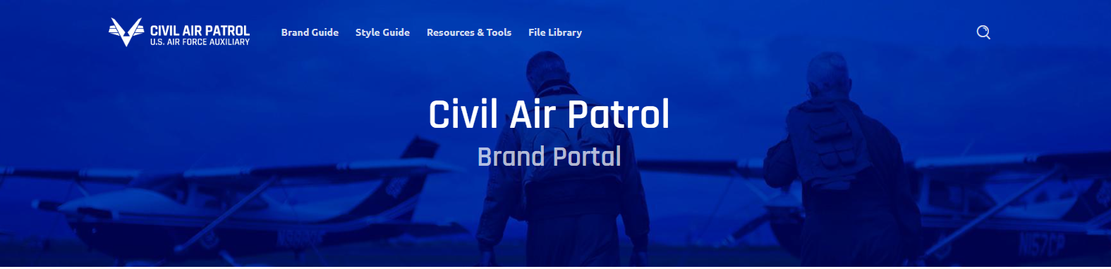
Making it useful for your membership
Where your creativity will be tested.
Ask yourself this:
  “What does my unit do well right now?”
  “What could we improve on?”
  “What tools are we not utilizing that are free?”
  “If I was a new person and I wanted to find something specific, how would I do that?”
  “Why do we have multiple different websites and locations to find information?”
  “Is this easily usable for the general public, our membership, and our more senior members?”

Slide 22
What NHQ/MAC has for YOU

Slide 23


A New Strategy
Notes:
Marketing is a much larger scope than public affairs alone.
Public Affairs, or Public Relations as we will call it going forward, is one very narrow marketing channel largely for reputation management. By itself though, it is not a growth strategy.
Marketing however, is a multi-discipline endeavor based on psychology, creativity, culture, emotion, and so much more – Public Relations is one aspect of a multi-facet approach to marketing and communications.

Slide 24
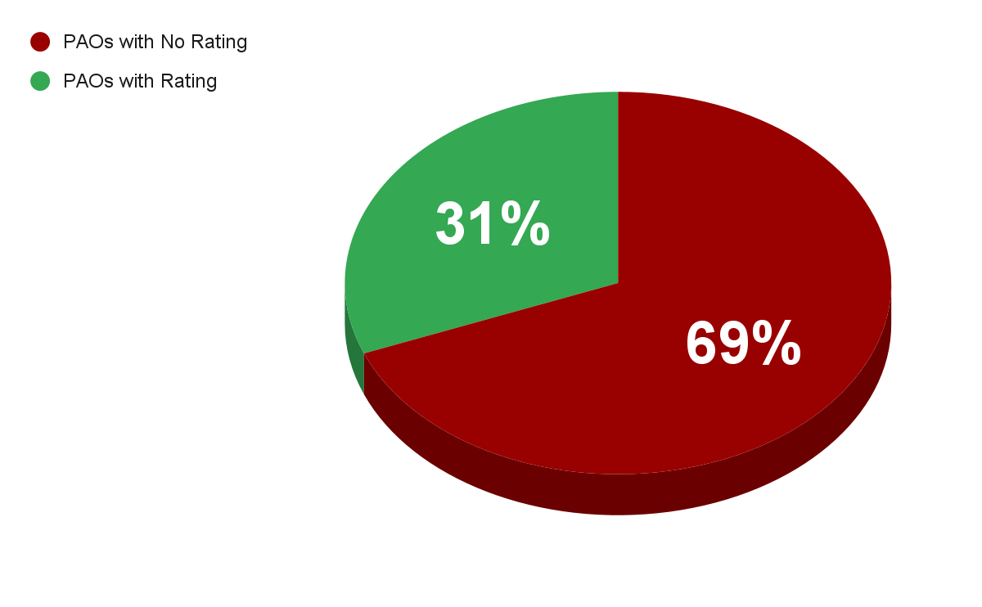
SITREP
The state of the current Public Affairs Program
551 PAOS
WITH A RATING
1242 PAOS
WITH NO RATING
Data As Of: Jan 20th, 2023
PAO Unit Assignment And Qualifications Report (eServices)
Notes:
To look ahead we also have to look back so as not to repeat history.
Under the current Public Affairs duty assignment, data pulled in Jan of this year, shows we have a total of 1800 PAOs.
Of those 1800 PAOs there are 551 with a rating.
A staggering 69% of PAOs are simply in a position with no rating.

Slide 25
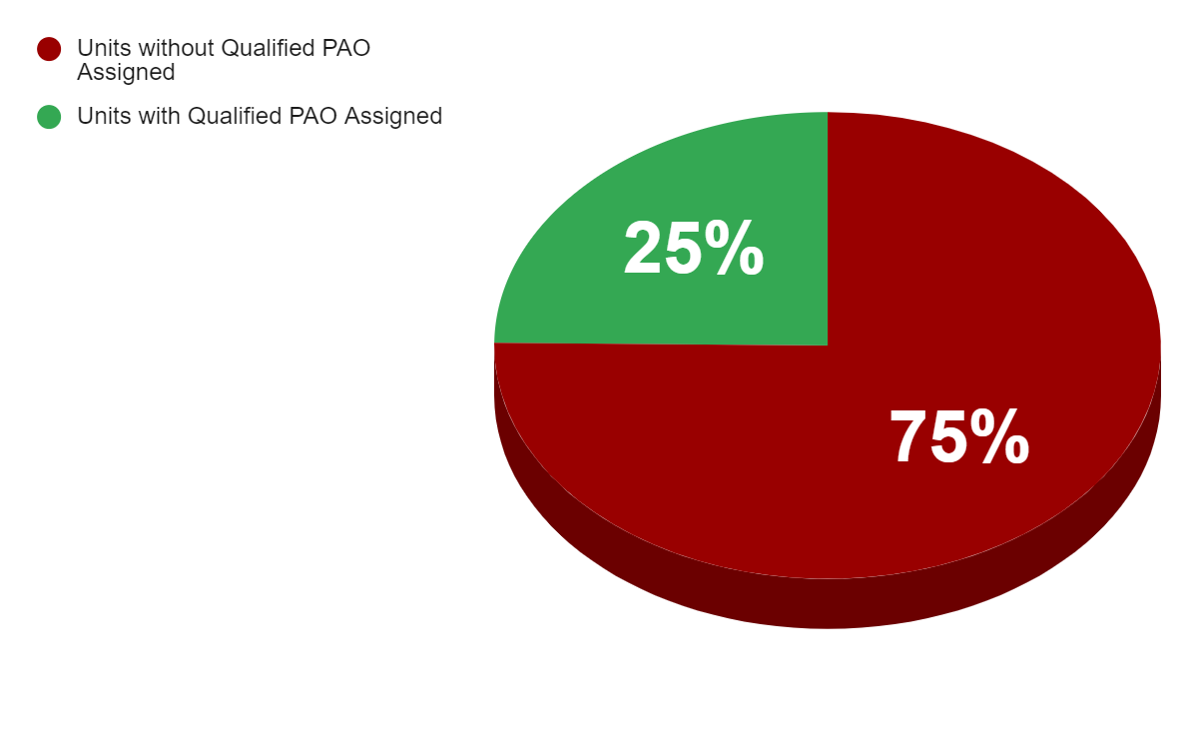
SITREP
The state of the current Public Affairs Program
350 UNITS
WITH A QUALIFIED PAO
1060 UNITS
WITHOUT A QUALIFIED PAO
Data As Of: Jan 20th, 2023
PAO Unit Assignment And Qualifications Report (eServices)
Notes:
More alarming, the 551 PAOs that have a specialty track rating cover just 350 units across the country, out of 1410.

Slide 26
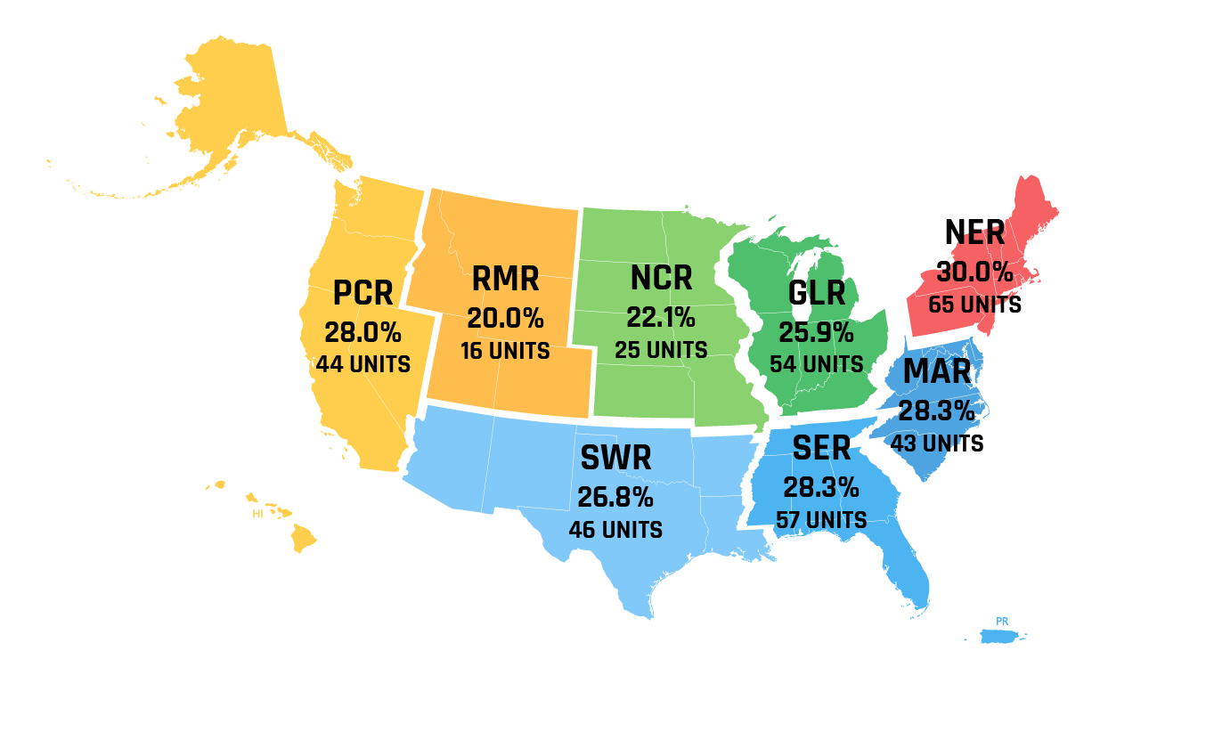
UNITS WITH A QUALIFIED PAO
OUT OF 1410 UNITS TOTAL
Data As Of: Jan 20th, 2023
PAO Unit Assignment And Qualifications Report (eServices)
Notes:
The negative impact of the lack of qualified PAO coverage can been seen across the board in all regions.

Slide 27
UNITS WITH A QUALIFIED PAO
OUT OF 1410 UNITS TOTAL
ON AVERAGE, 75% OF UNITS IN ALL REGIONS
HAVE EITHER AN UNRATED PAO
OR NO PAO AT ALL.
Data As Of: Jan 20th, 2023
PAO Unit Assignment And Qualifications Report (eServices)
Notes:
Leaving 75% of units without a properly qualified PAO or no PAO at all. This is staggering.

Slide 28


Best
Kept
Secret
1410 Units Trying To Tell
Their Individual Stories
We Need 1410 Units Telling a
Story That is Consistent with
National Strategy
Notes:
In part it is why we have earned the moniker, “The Best Kept Secret.”
Rather than over 1400 individual stories being told, and that’s not even including groups, regions, NCSAs, other directorates.
We need a singular marketing focus on Civil Air Patrol’s story.
How do we get there?
I’m glad you asked.

Slide 29

Best
Kept
Secret
1410 Units Trying To Tell
Their Individual Stories
We Need 1410 Units Telling a
Story That is Consistent with
National Strategy
Notes:
First we work to eliminate the best kept secret mantra by training up a new field-level marketing team.

Slide 30
Graphics & Templates
To ensure that units across Civil Air Patrol are using standardized marketing materials, we've created numerous graphics templates.
The templates can be customized for specific units, missions, directorates, events and more. Many of the templates are available in a wide variety of sizes and formats, allowing you to pick and choose what works best for your needs and budget.
A dedicated team of volunteer and paid members, from multiple different disciplines and fields, working for your success.

Slide 31

CREATIVE SERVICES
MARKETING & COMMUNICATIONS
Expertise in creative
Create brand compliant services for national and wings
Internal and external audiences
Manage the brand
Strengthen relations
Enable the organization to grow
PUBLIC RELATIONS
Work with media
Public relations
TRAINING
Support wing MAC teams
Mentor and assist
Create training materials
DIGITAL ENGAGEMENT
Digital plan on the web
Websites
Social media
Notes:
The national MAC team encompasses both paid staff and volunteer members whose purpose is to connect with internal and external audiences to show CAP’s national value, manage the brand, and strengthen relations with key audiences and customers to enable the organization to grow.

Slide 32
15 Useful Social Media Tips

Slide 33

15 Useful Social Media Tips
#1 No FOUO or sensitive information; think OPSEC
Don’t post classified, sensitive, or For Official Use Only information. If in doubt, talk to your supervisor, commander, IC, or PAO/PIO.

Slide 34
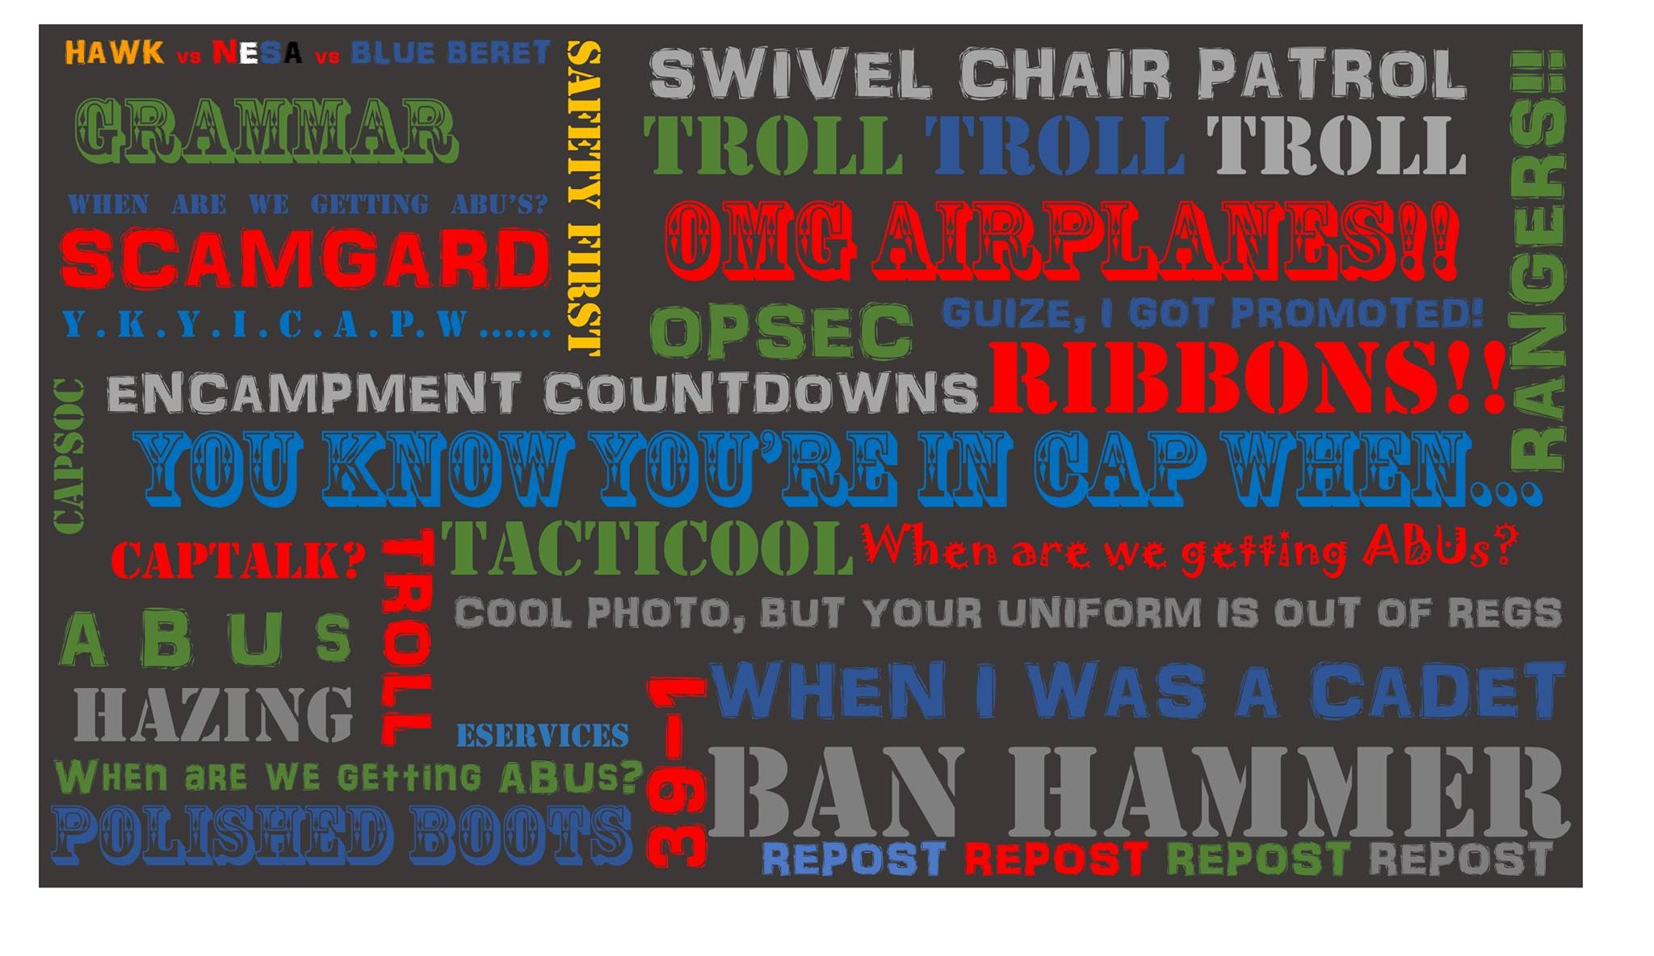
15 Useful Social Media Tips
#2 Stay in your lane
Discussing issues related to your CAP specialty, mission qualification, duty position, or personal experiences are acceptable and encouraged, but you shouldn’t discuss areas of expertise where you have no firsthand, direct experience, or knowledge.

Slide 35
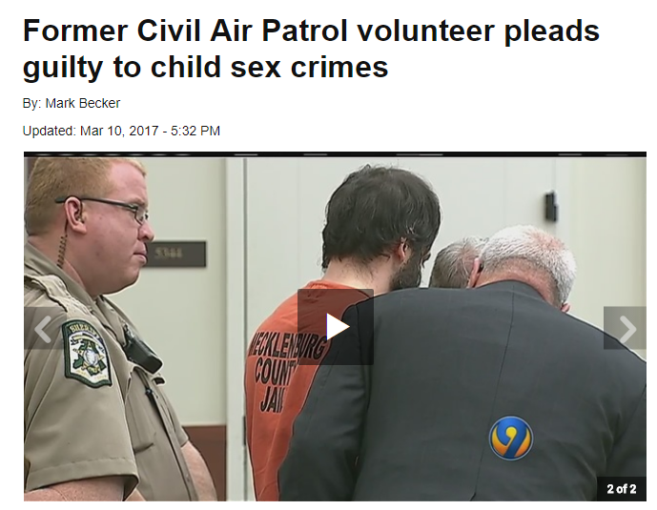
15 Useful Social Media Tips
#3 You must keep federal, state, and local laws, CAP regulations, and even FAA rules in mind when using social media in official and unofficial capacities. You are a CAP member 24 hours a day, 365 days a year.

Slide 36
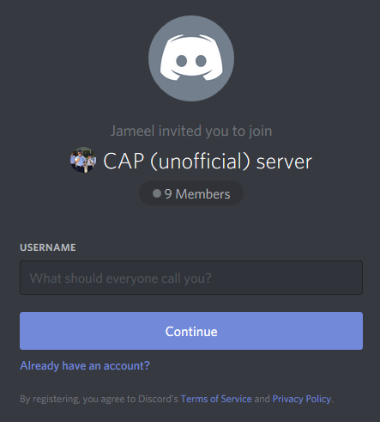
15 Useful Social Media Tips
#4 Differentiate between opinion and official information
Yes, tell them what you think — just make sure you state that this is your opinion and not that of the organization.

Slide 37
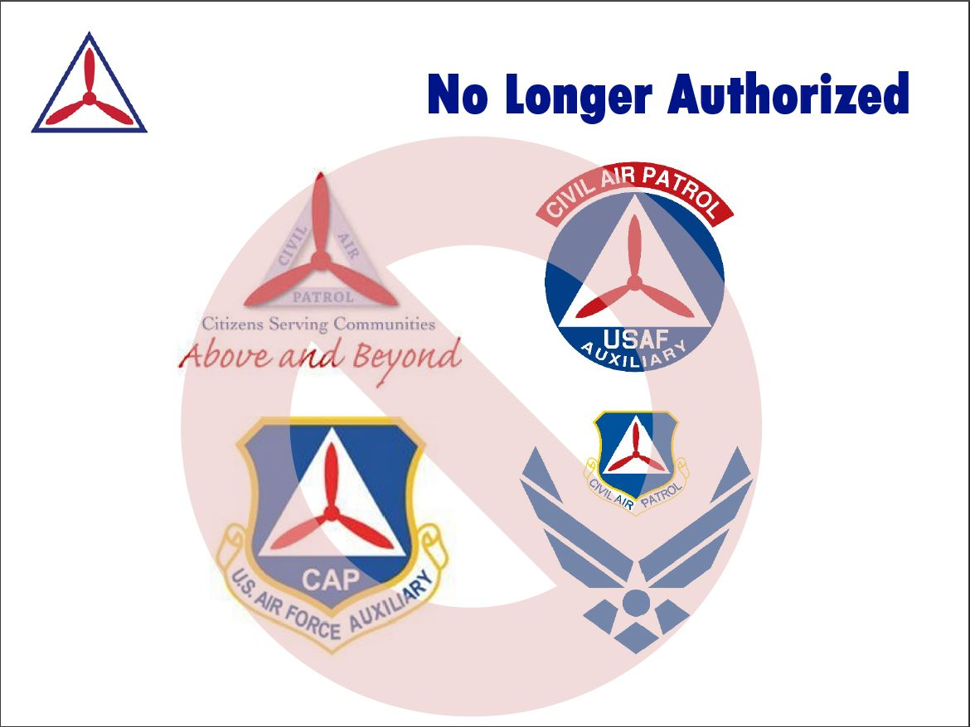
15 Useful Social Media Tips
#5 Use your best judgment
What you write may have serious consequences. Once you post something on social media, you can’t “get it back.” Even deleting the post doesn’t mean it’s truly gone. Ultimately, you bear sole responsibility for what you post.

Slide 38
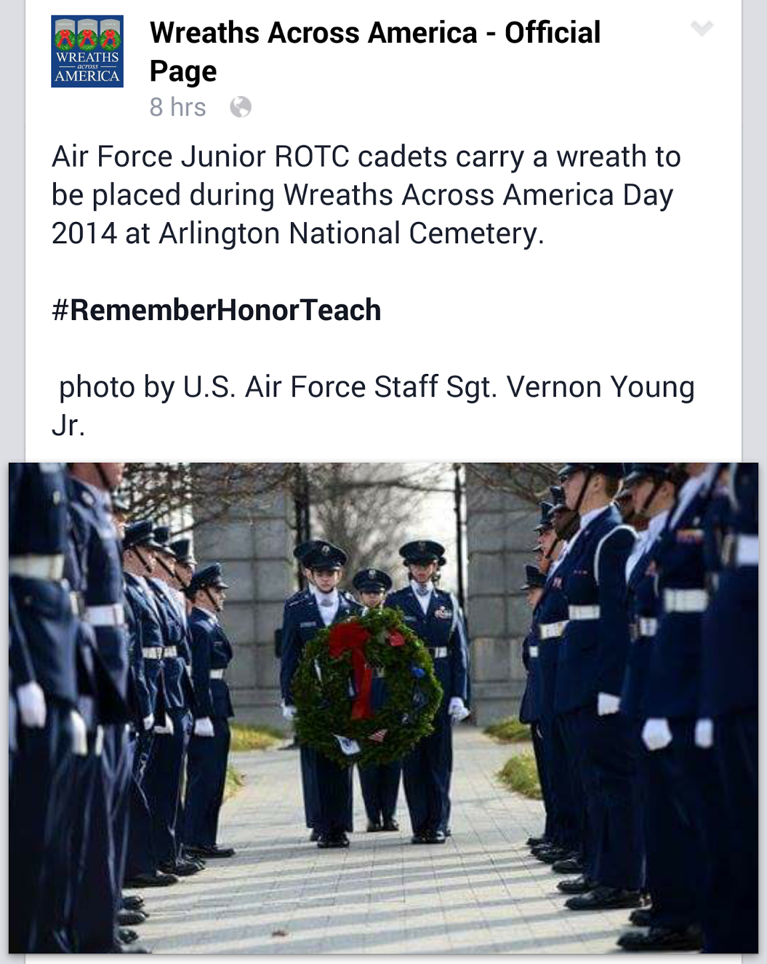
15 Useful Social Media Tips
When you see misrepresentations made about CAP in social media, you may certainly identify and correct the error. Always do so with respect and with the facts. When you speak to someone who has an adversarial position, make sure what you say is factual and respectful. Don’t argue, just correct the record.

Slide 39
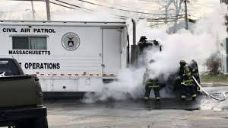
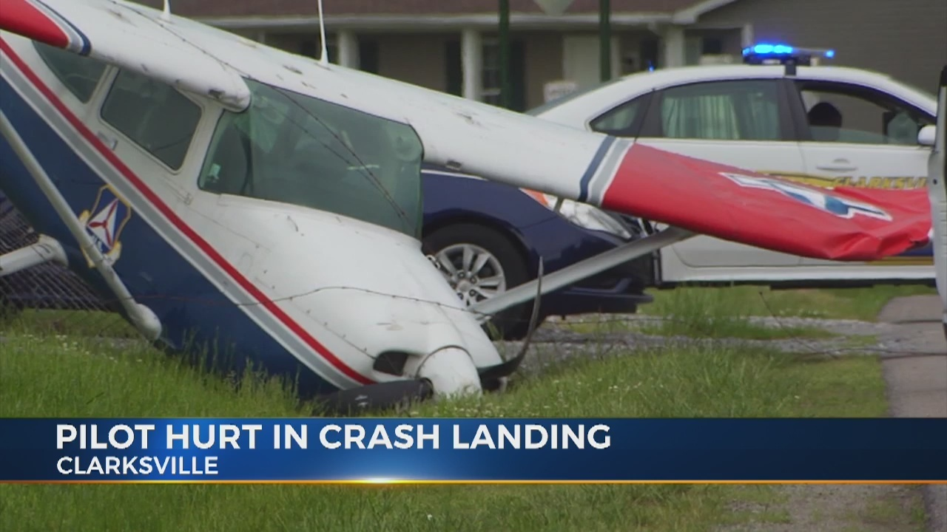
15 Useful Social Media Tips
#7 Be aware of the image you present
Any time you engage in social media, you’re representing CAP and the Air Force. Don’t do anything that discredits you or our organization.
Don’t forget, we can not refer to ourselves as the “Air Force Academy Light” or the encampment experience as “basic training”

Slide 40
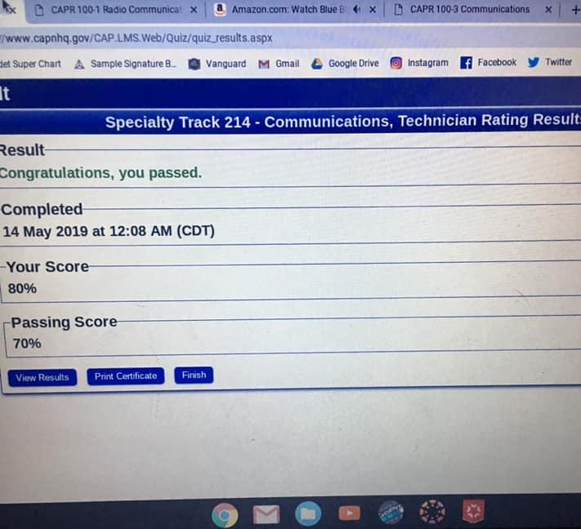
15 Useful Social Media Tips
#8 Be cautious with information sharing
Maintain privacy settings on your social media accounts, change your passwords regularly, and don’t give out personally identifiable information. Be cautious about the personal details you share on the Internet.

Slide 41
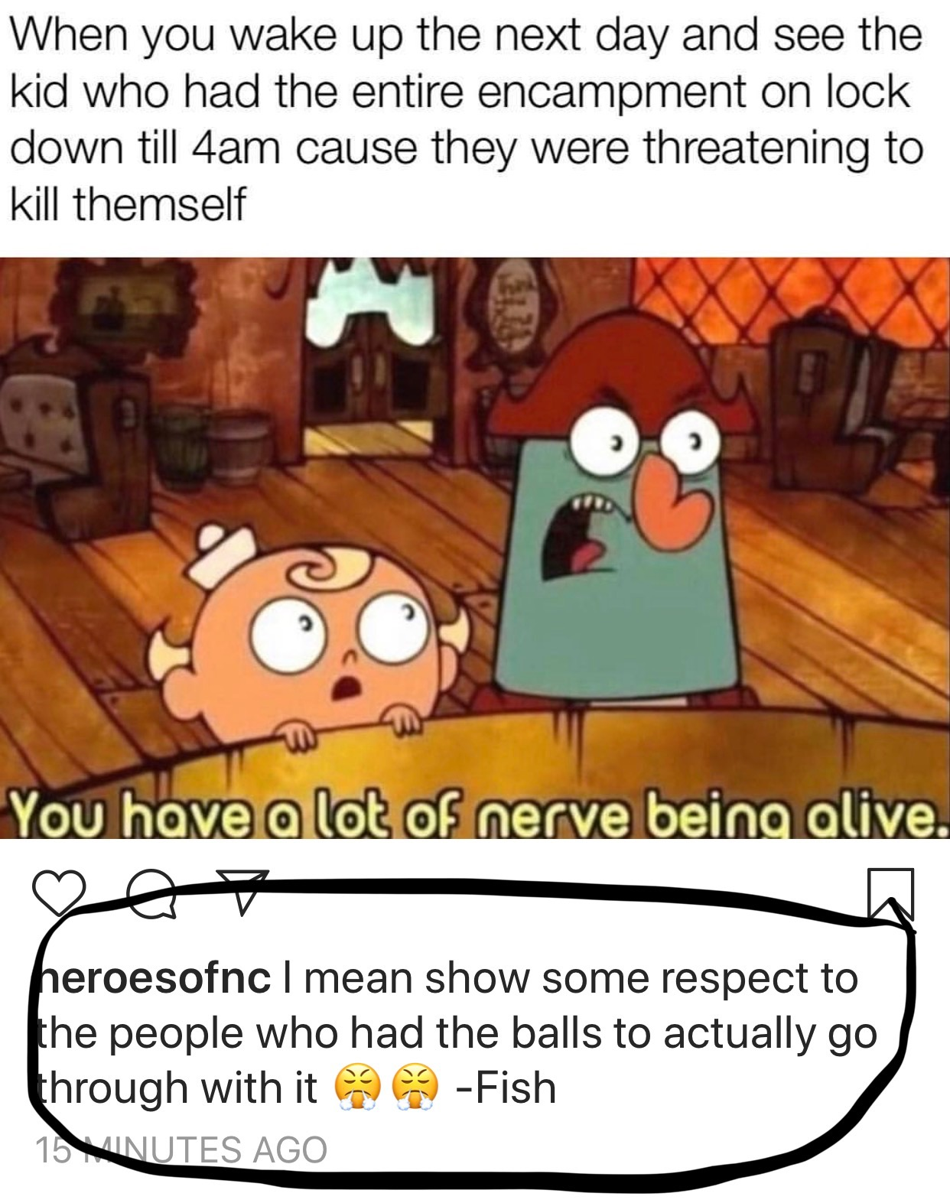
15 Useful Social Media Tips
#9 Avoid the offensive
Don’t post any defamatory, libelous, vulgar, obscene, abusive, profane, threatening, racially or ethnically hateful or otherwise offensive, or illegal information or material.

Slide 42

15 Useful Social Media Tips
#10 Don’t violate privacy
Don’t post any information that would infringe upon the proprietary, privacy, or personal rights of others.

Slide 43
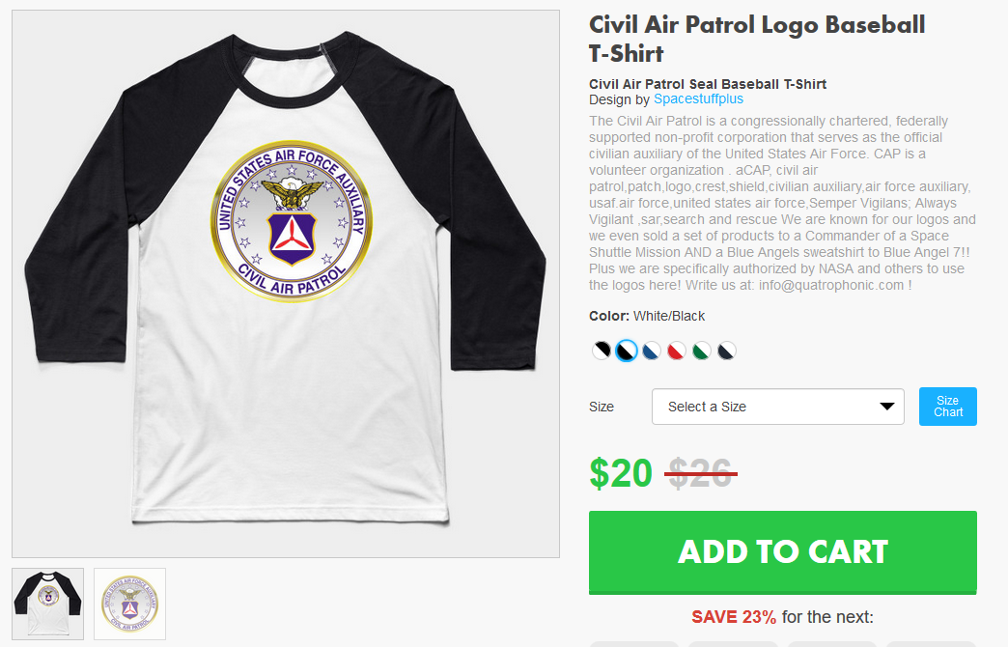
15 Useful Social Media Tips
#11 Don’t violate copyright
Don’t post any information or other material protected by copyright without the permission of the copyright owner.

Slide 44

15 Useful Social Media Tips
#12 Don’t misuse trademarks
Don’t use any words, logos or other marks that would infringe upon the trademark, service mark, certification mark, or other intellectual property rights of the owners of such marks without owner permission.
Air Force Symbol
CAP Logo

Slide 45
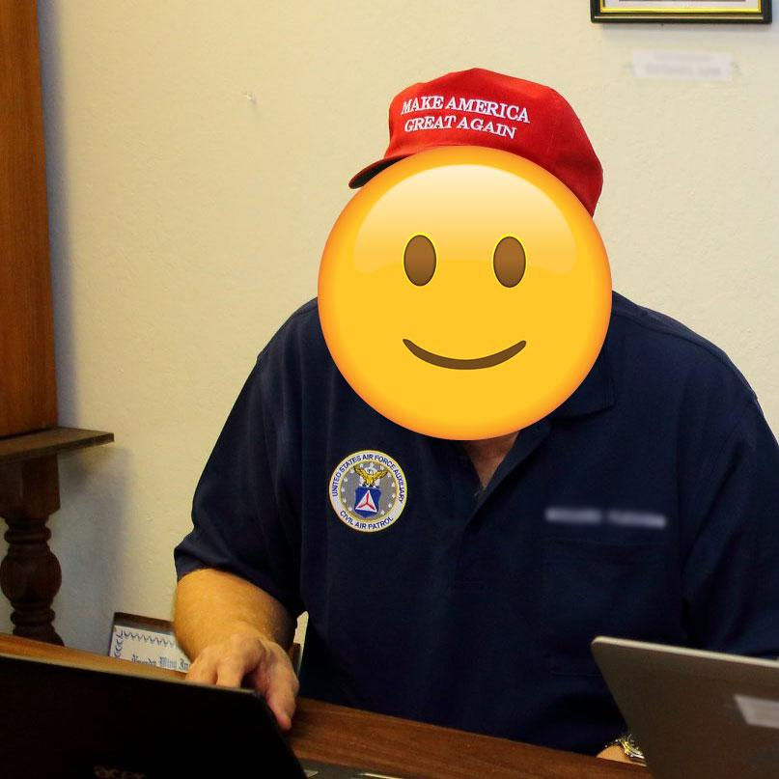
15 Useful Social Media Tips
#13 No endorsements
Don’t use the CAP or Air Force name to endorse or promote products, political positions, or religious ideologies.

Slide 46
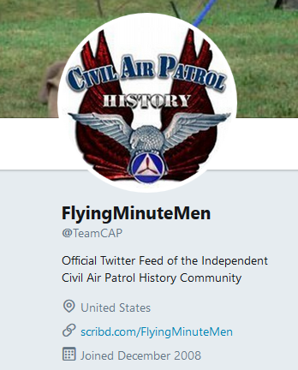
15 Useful Social Media Tips
#14 No impersonations
Don’t manipulate identifiers in your post to disguise, impersonate or otherwise misrepresent your identity or affiliation with any other person or entity.

Slide 47
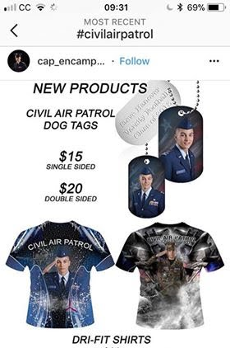
15 Useful Social Media Tips
#15 Don’t promote yourself for personal or financial gain
Don’t use your CAP affiliation, official title, or position to promote, endorse, or benefit yourself or any profit-making group or agency. Don’t show Air Force involvement when fundraising.

